Slide 1
Welcome to Strausser
Elementary School

Slide 2
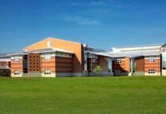
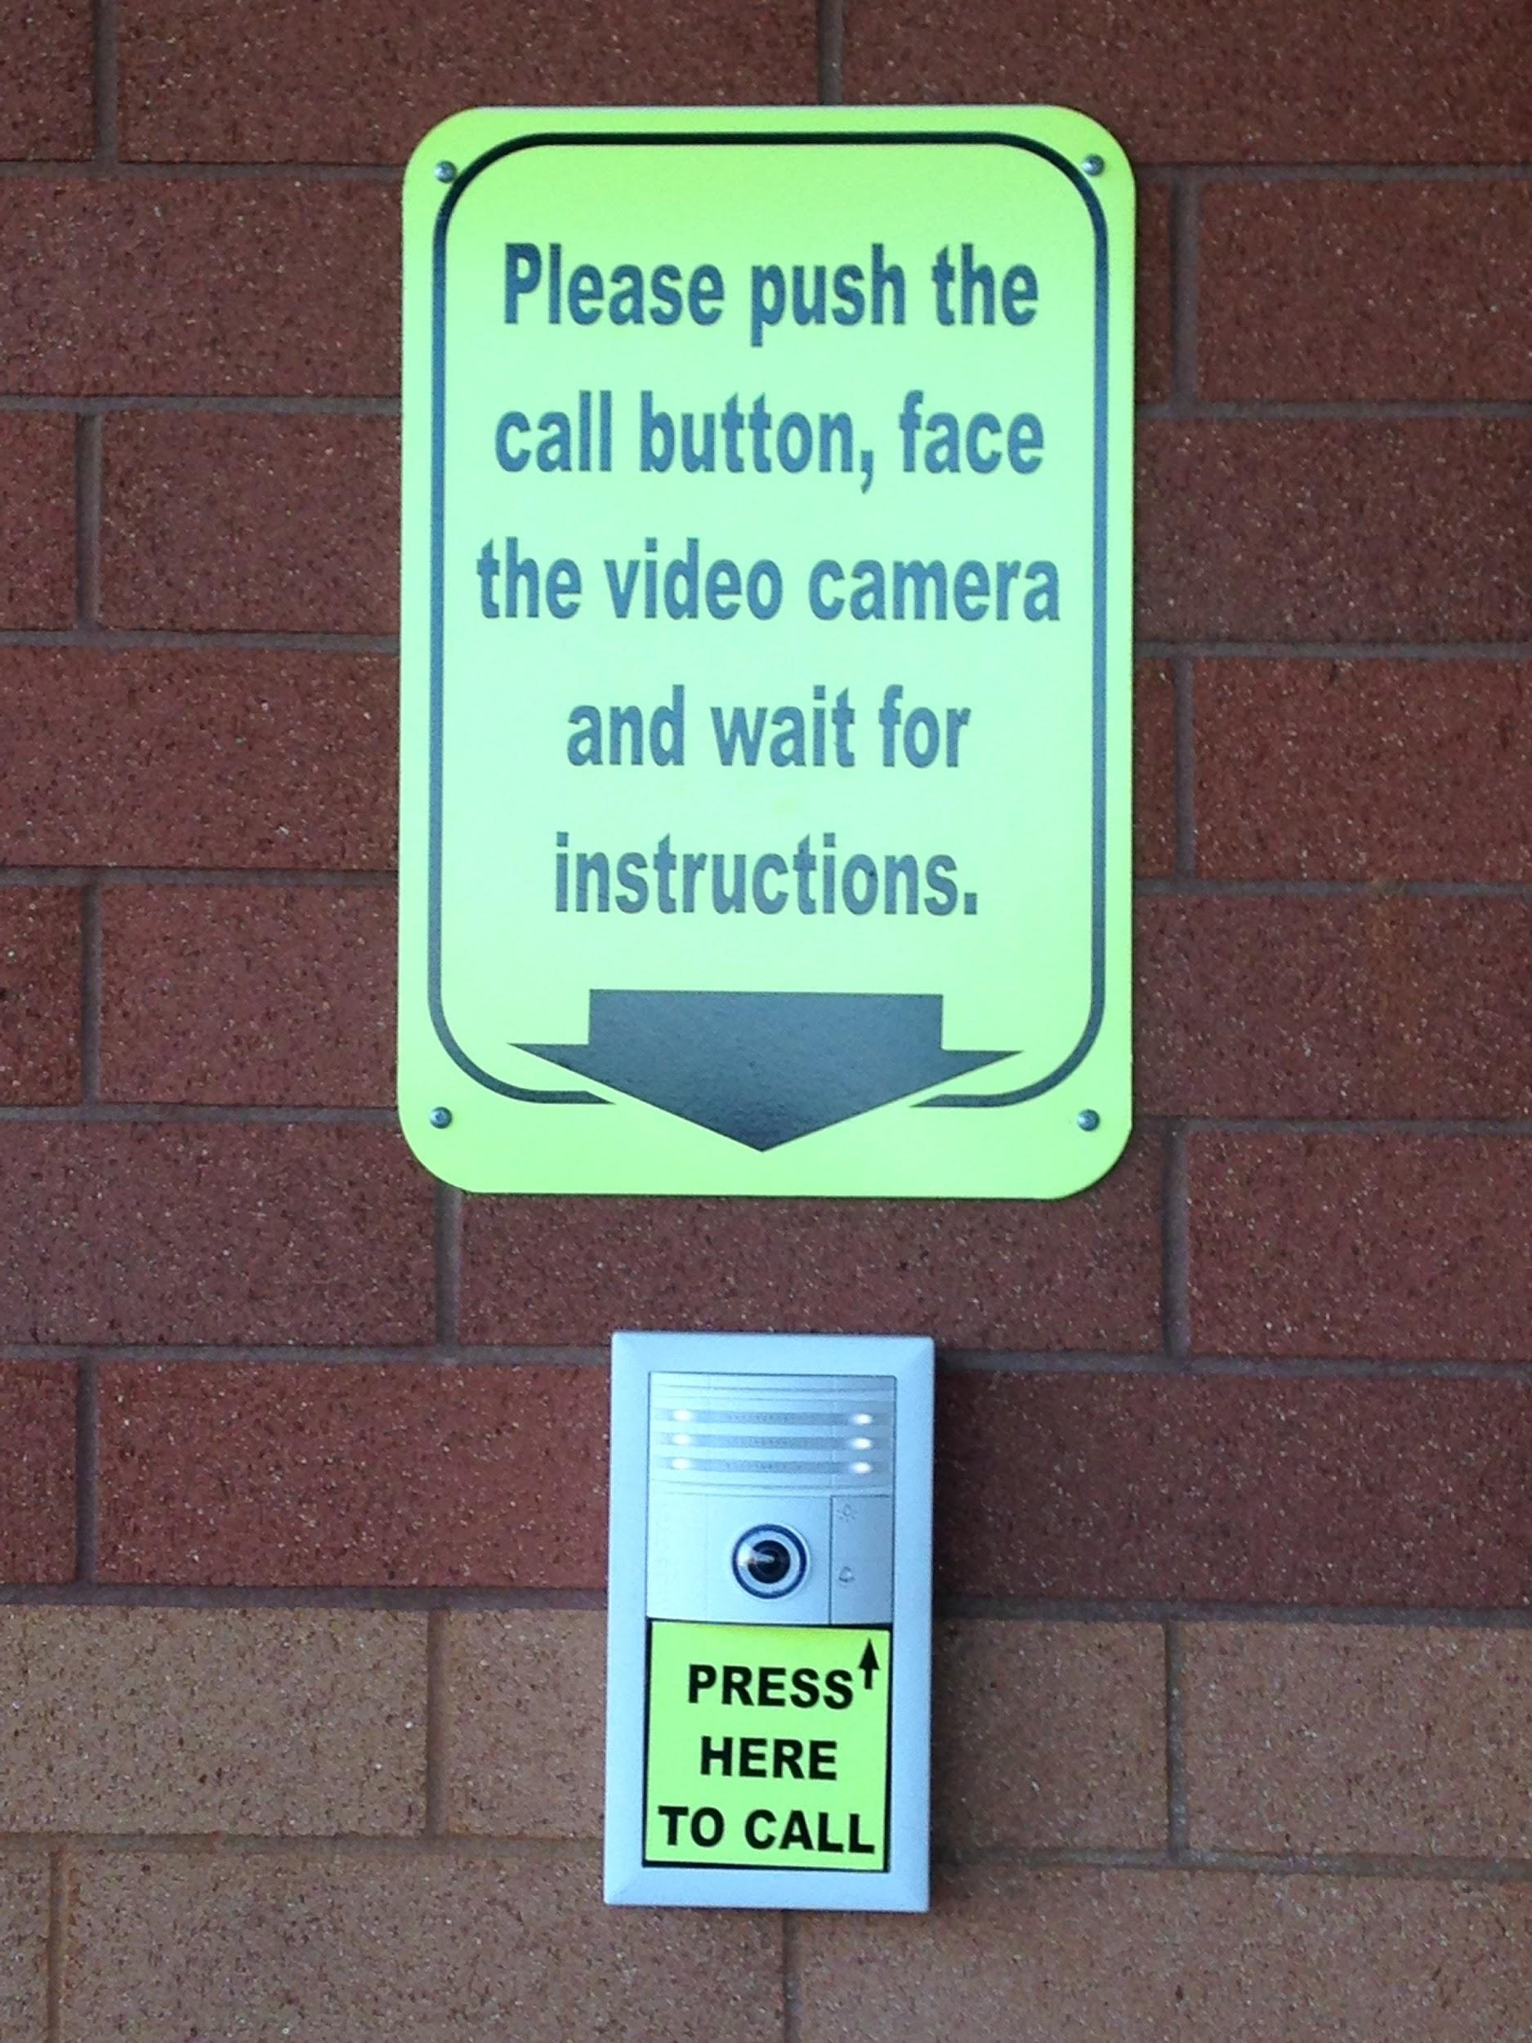
Student and Staff Safety
To enter the building:
Follow the directions on the image to the right.
State your name and the purpose for your visit.
Produce a valid driver’s license.

Slide 3
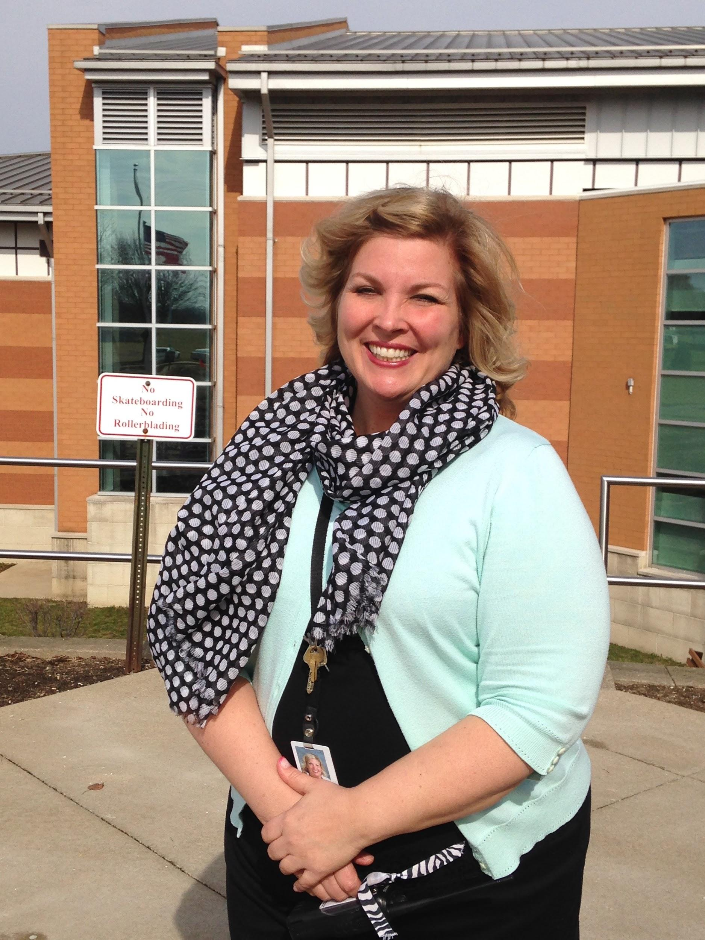
Meet your Principal, Mrs. Waltman
Mrs. Waltman welcomes you to Strausser Elementary School. She is very excited that you have joined the Jackson Local Schools community!

Slide 4
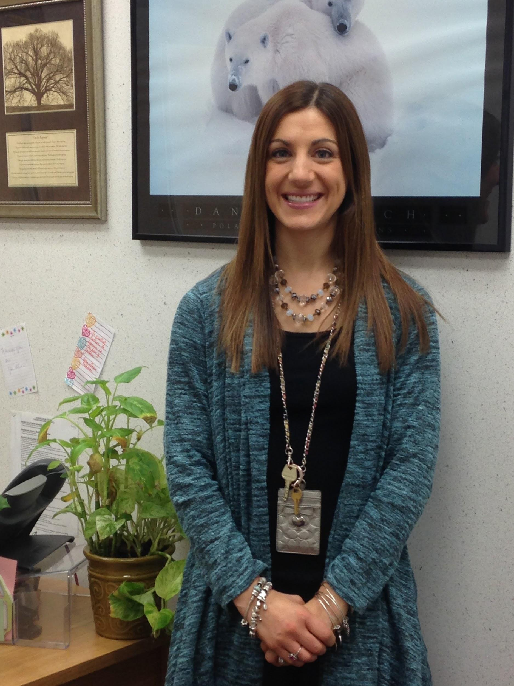
Meet your Dean of Students, Mrs. Krieg
Mrs. Krieg welcomes you to Strausser Elementary School. She works with Mrs. Waltman in the office and cannot wait to meet you!

Slide 5
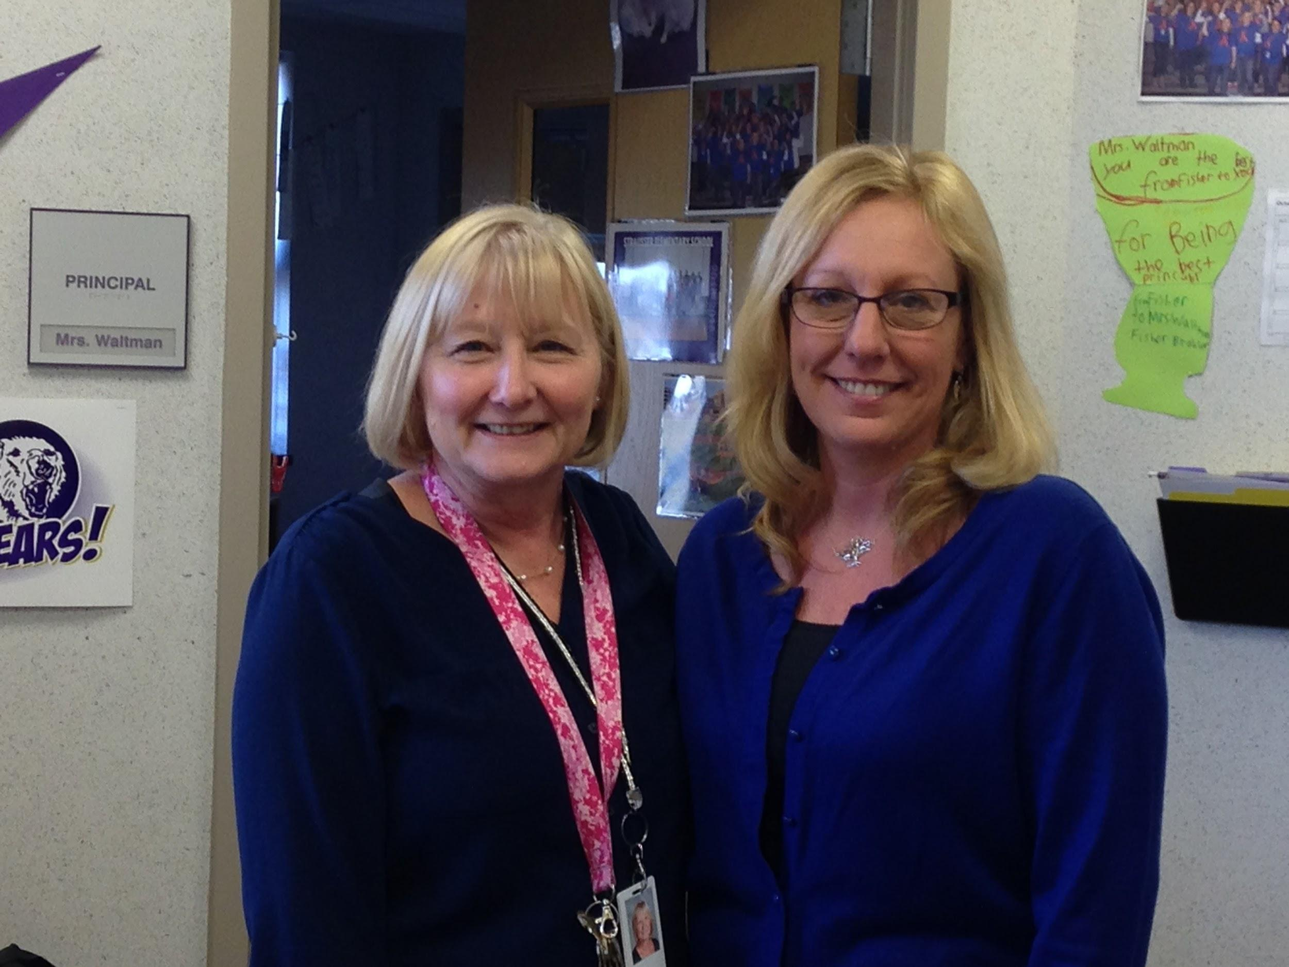
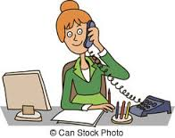
Meet your Building Secretary and Building Aide; Mrs. Tentler and Mrs. Schuller. Please make sure that notes from home are turned in to your classroom teacher each day. Please include your child’s first and last name, your name, and teacher’s name printed clearly.

Slide 6
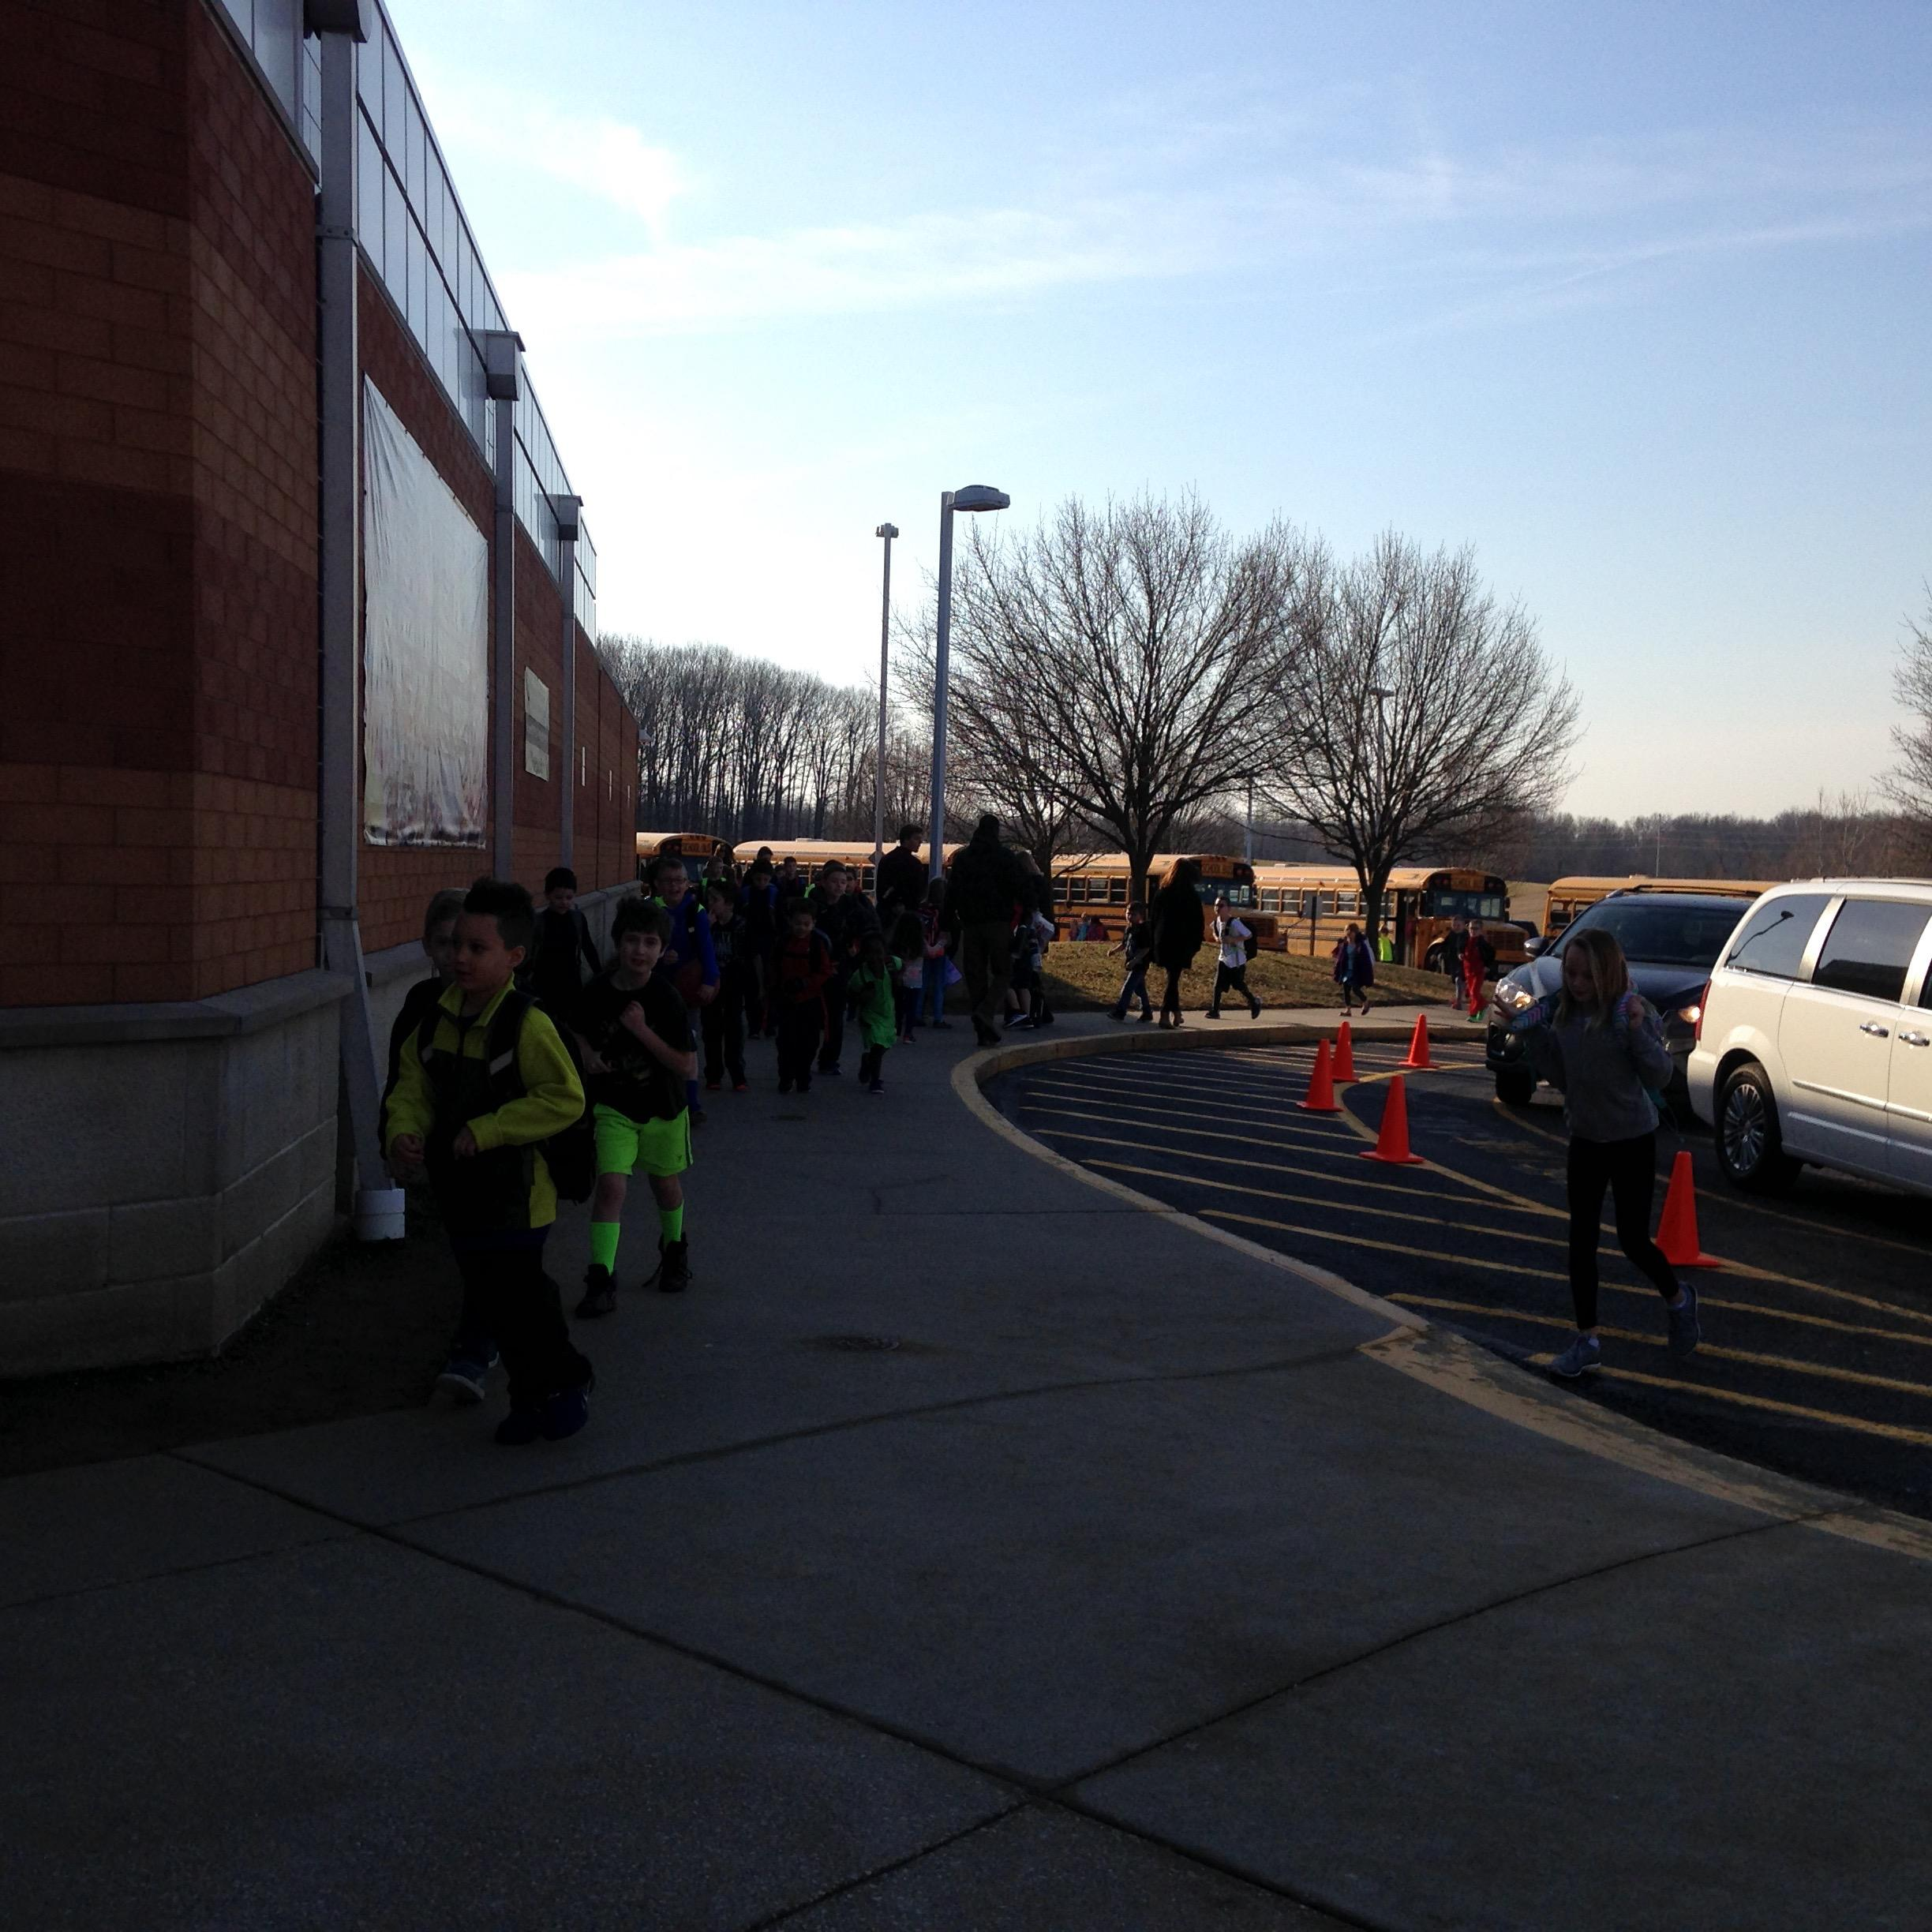
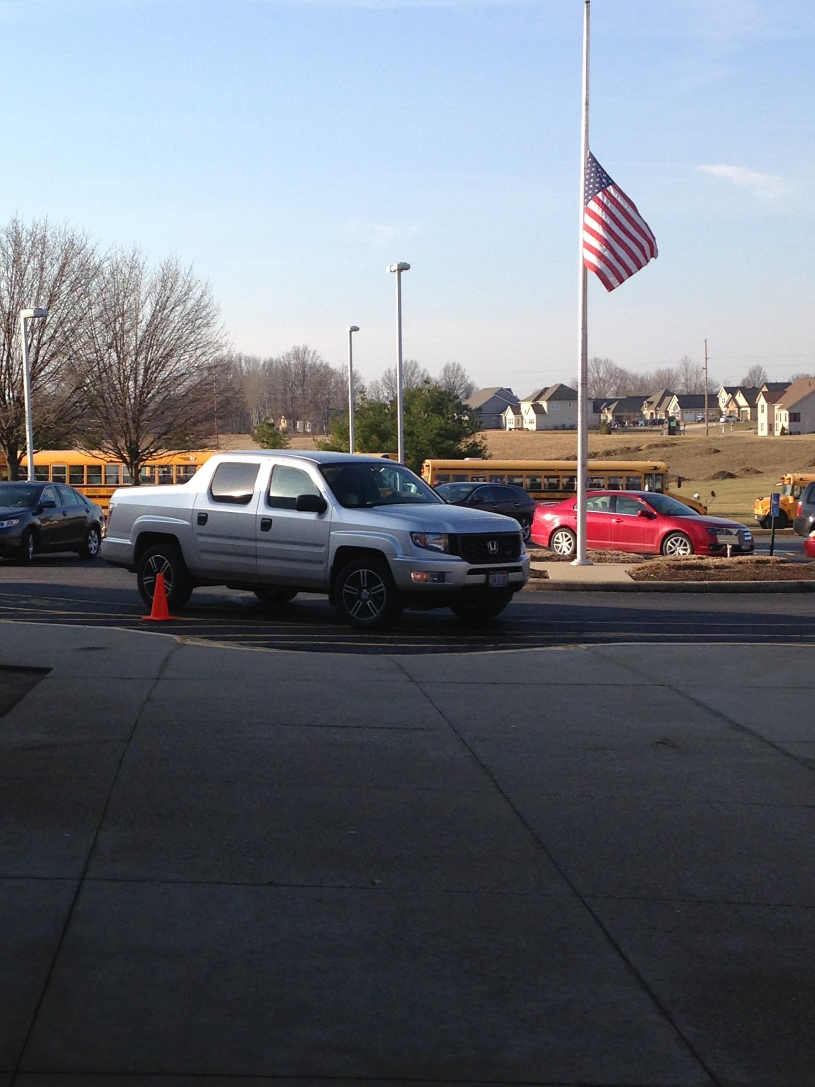
Arriving and departing school
School Bus
Parent Drop-Off

Slide 7
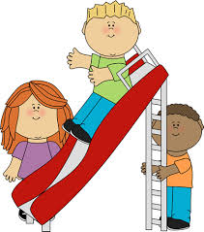
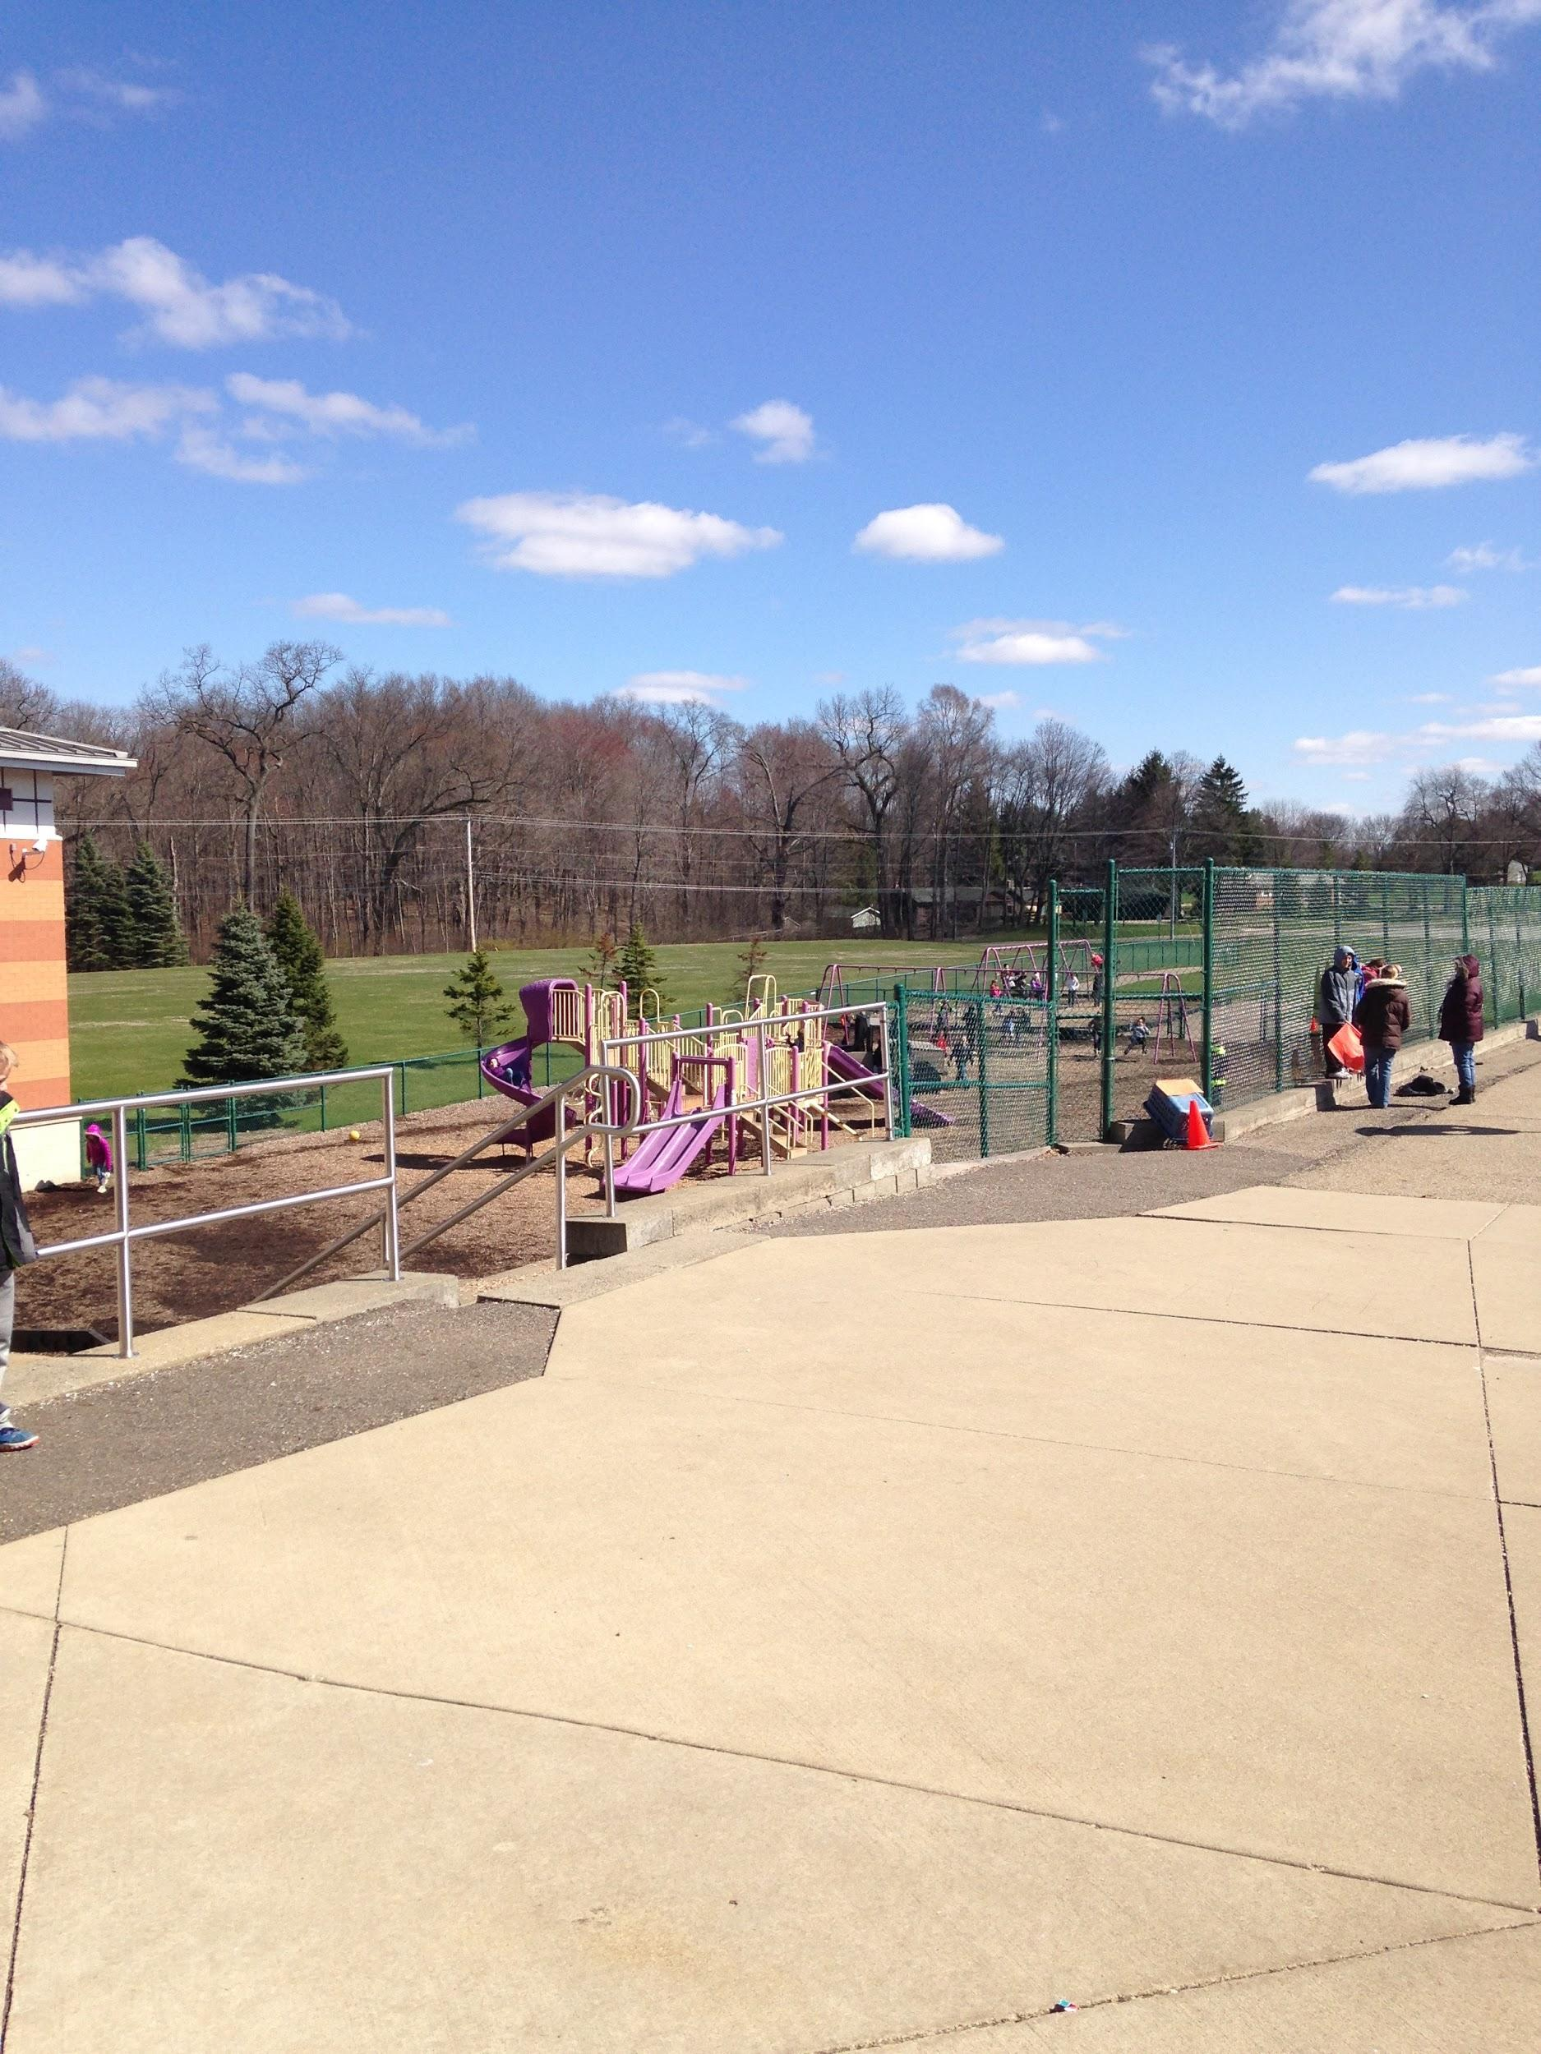
Recess
Recess is 15 minutes daily. Please dress for the weather!
Parents, please feel free to bring your child to the playground during non-school hours. They will feel more at ease during recess!

Slide 8
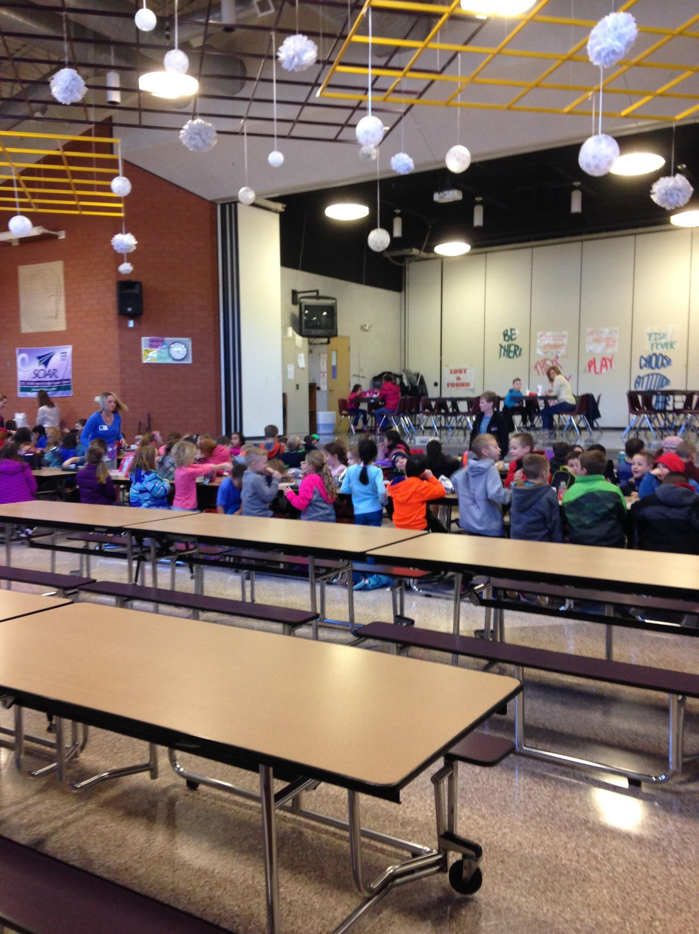
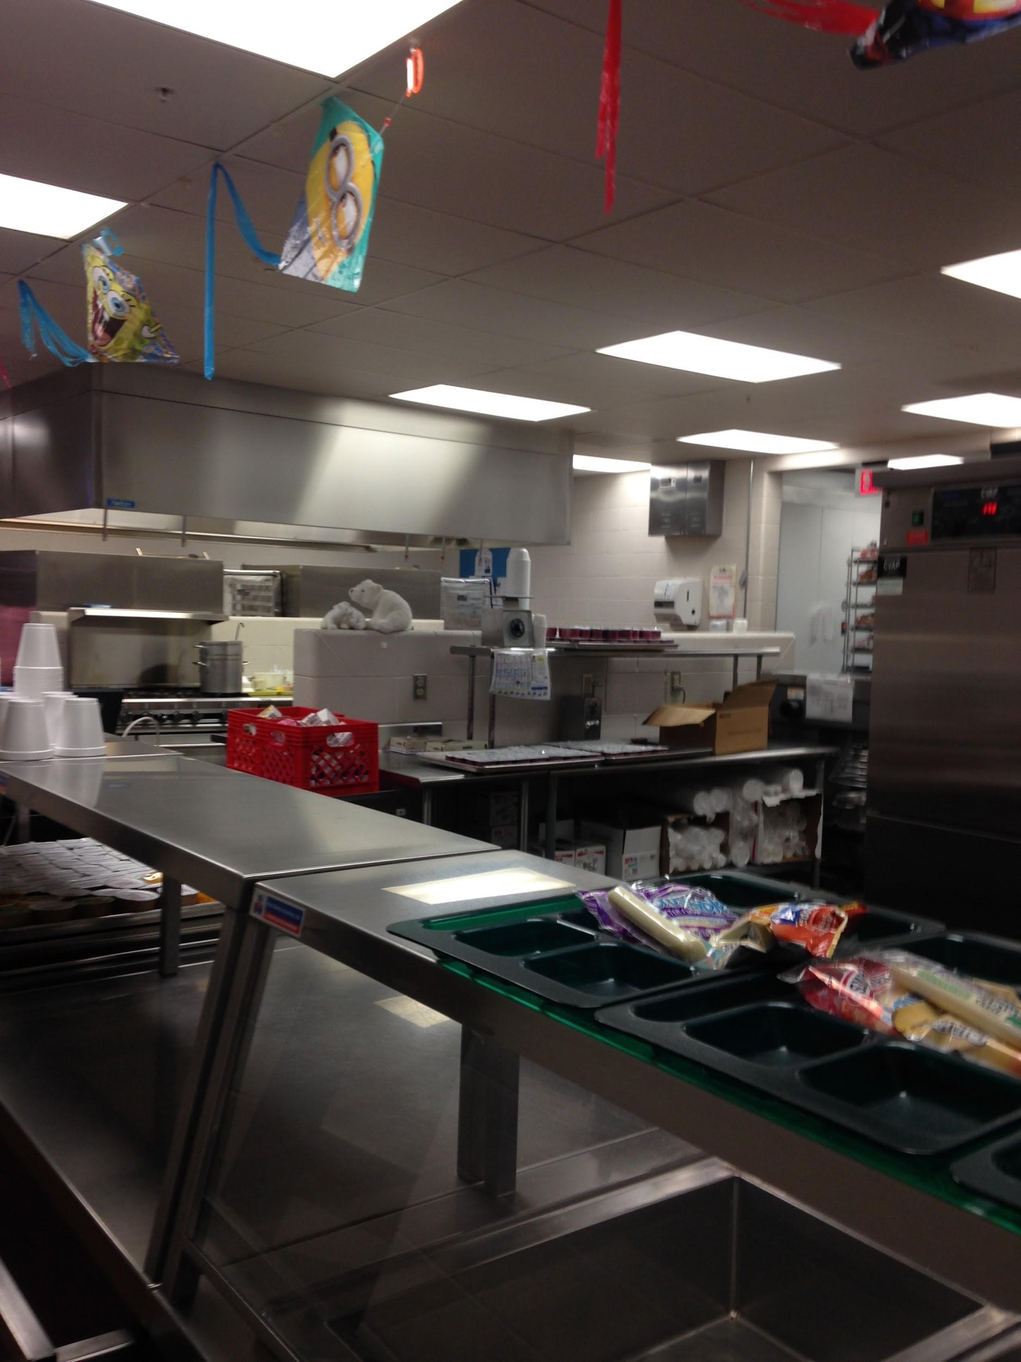
Cafeteria
You have 30 minutes to eat your lunch. You may buy or pack. If you buy, you pay for your lunch using a special code (which is also the student’s computer password.
Click here for menu!

Slide 9
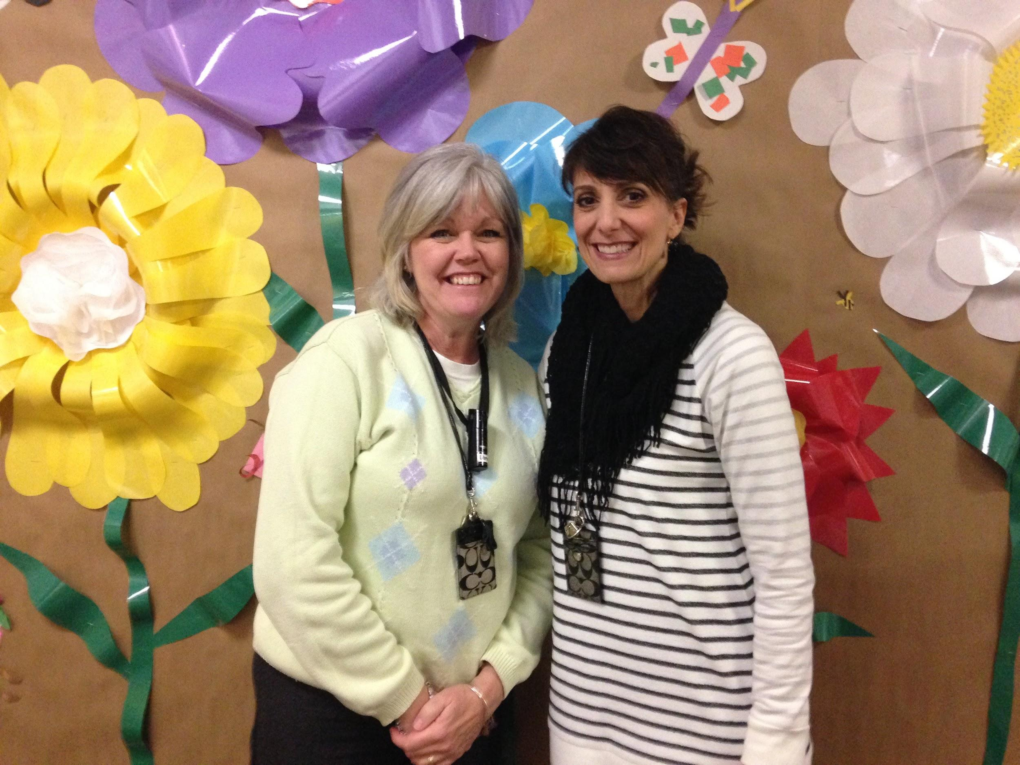
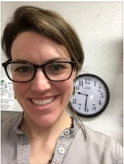
Library
Click here to link to our libraries!
You get to spend 35 minutes per week with Mrs. Lyons, Mrs. Vicini, and Mrs. Hamilton. You’ll hear wonderful stories and get to borrow books to read at home.
Would you like to volunteer? Please email Mrs. Lyons
jml2jc@jackson.sparcc.org
Mrs. Lyons &
Mrs. Vicini
Mrs. Hamilton

Slide 10
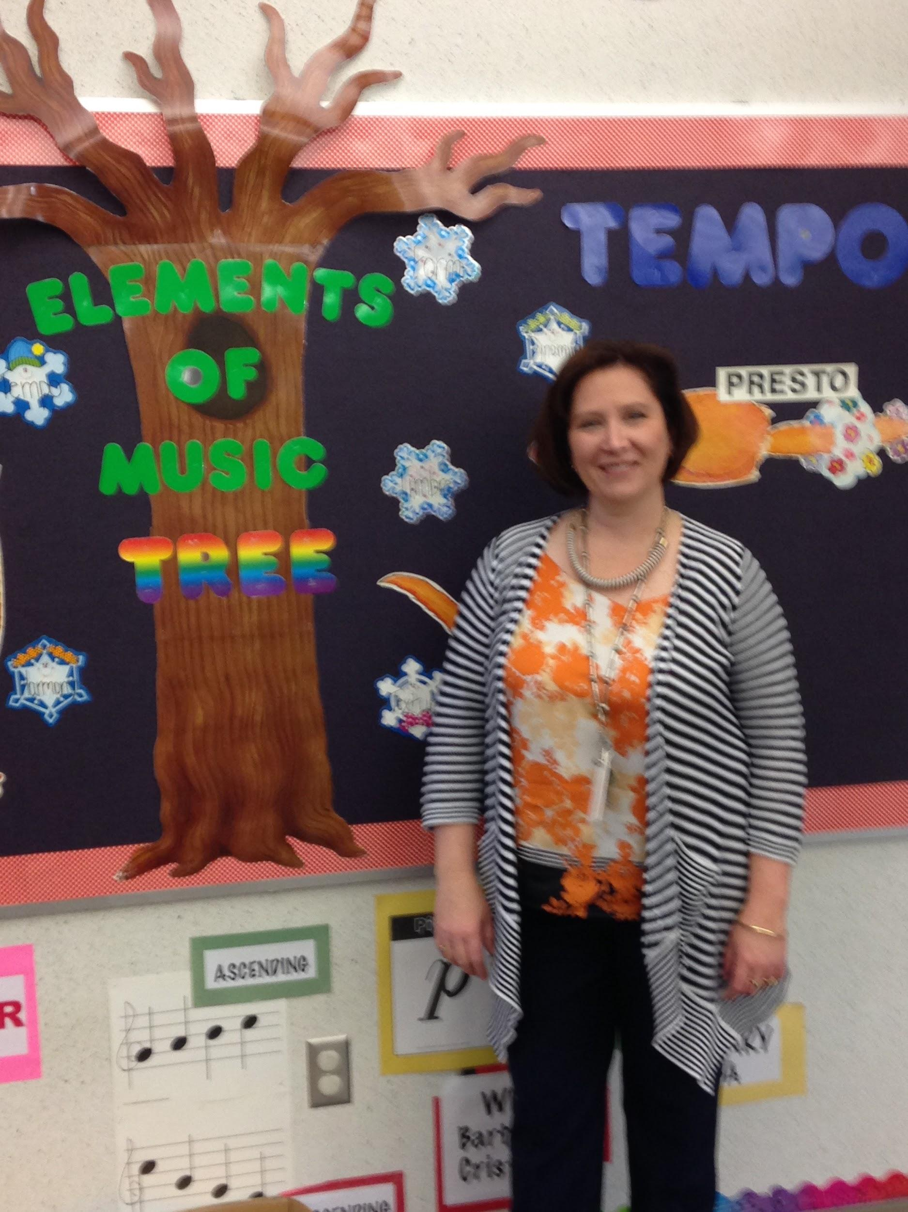
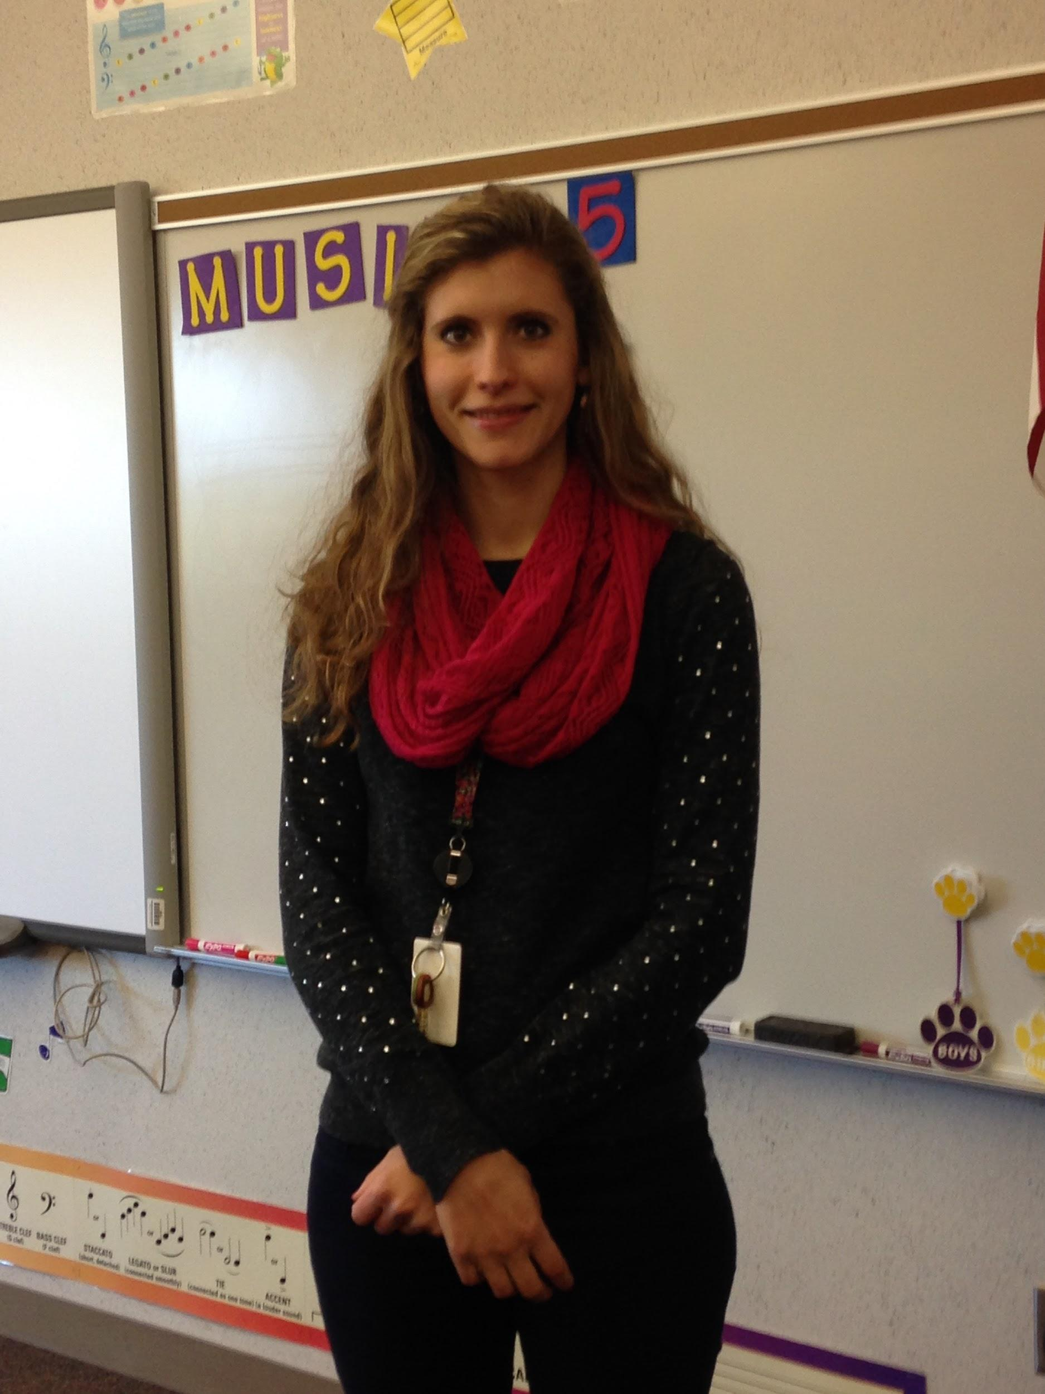
Music
You can enjoy 70 minutes per week with Mrs. Walters or Miss Bullach. Singing is so much fun!
Mrs. Walters
Miss Bullach

Slide 11
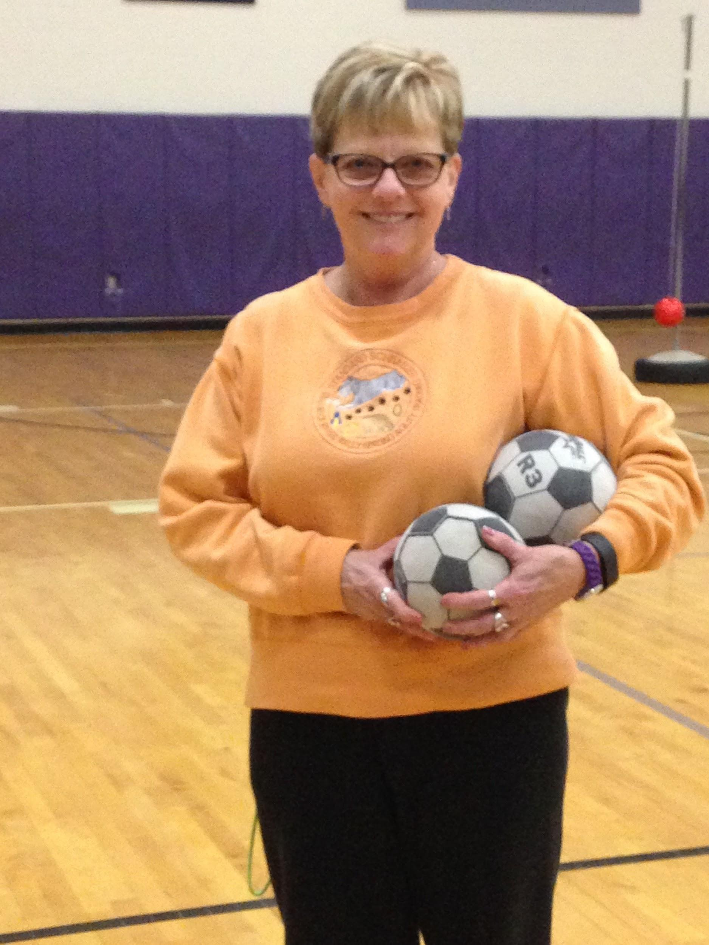
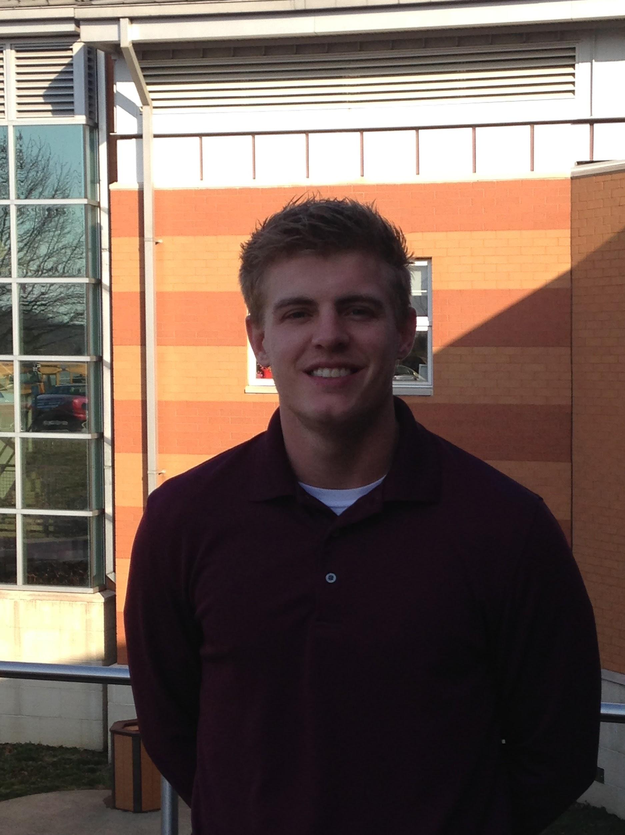
Physical Education
Spend 70 minutes per week with Mr. Coon or Mrs. Arnold. They will keep you in tip-top shape!
Mrs. Arnold
Mr. Coon

Slide 12
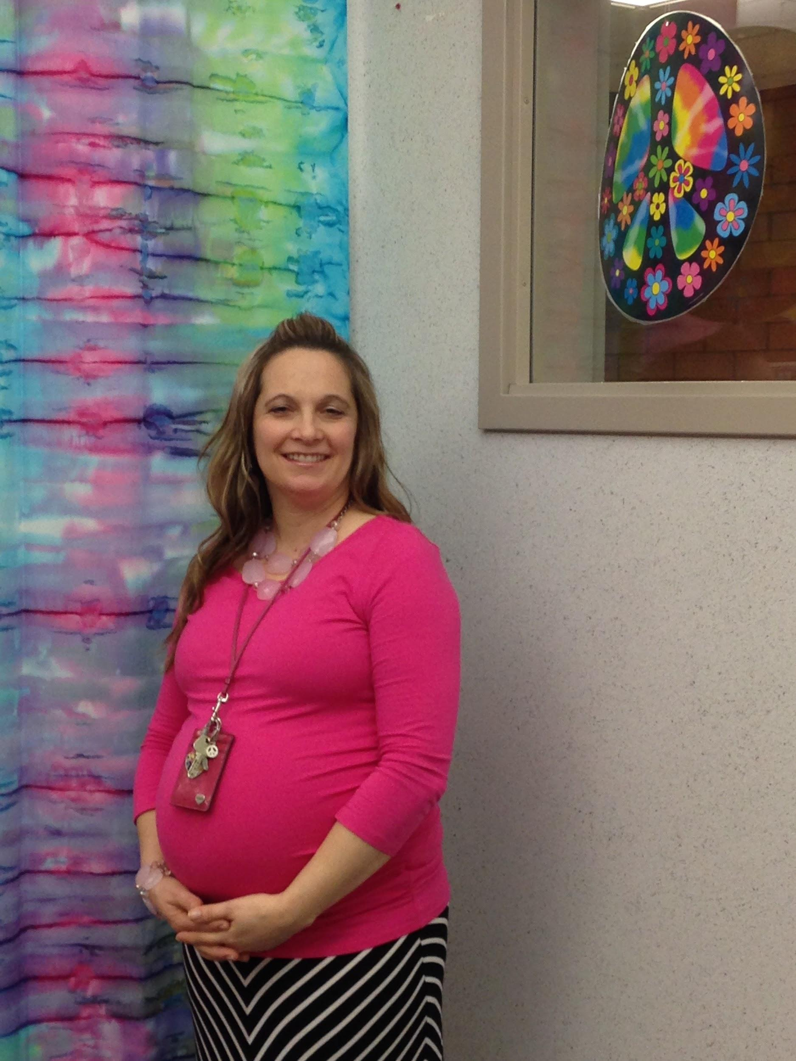
School Counselor
Click here for Mrs. Neff’s site.
Mrs. Neff is your building school counselor. She is here to listen and support students. Ask her what it means to be a “Bucket Filler”!

Slide 13
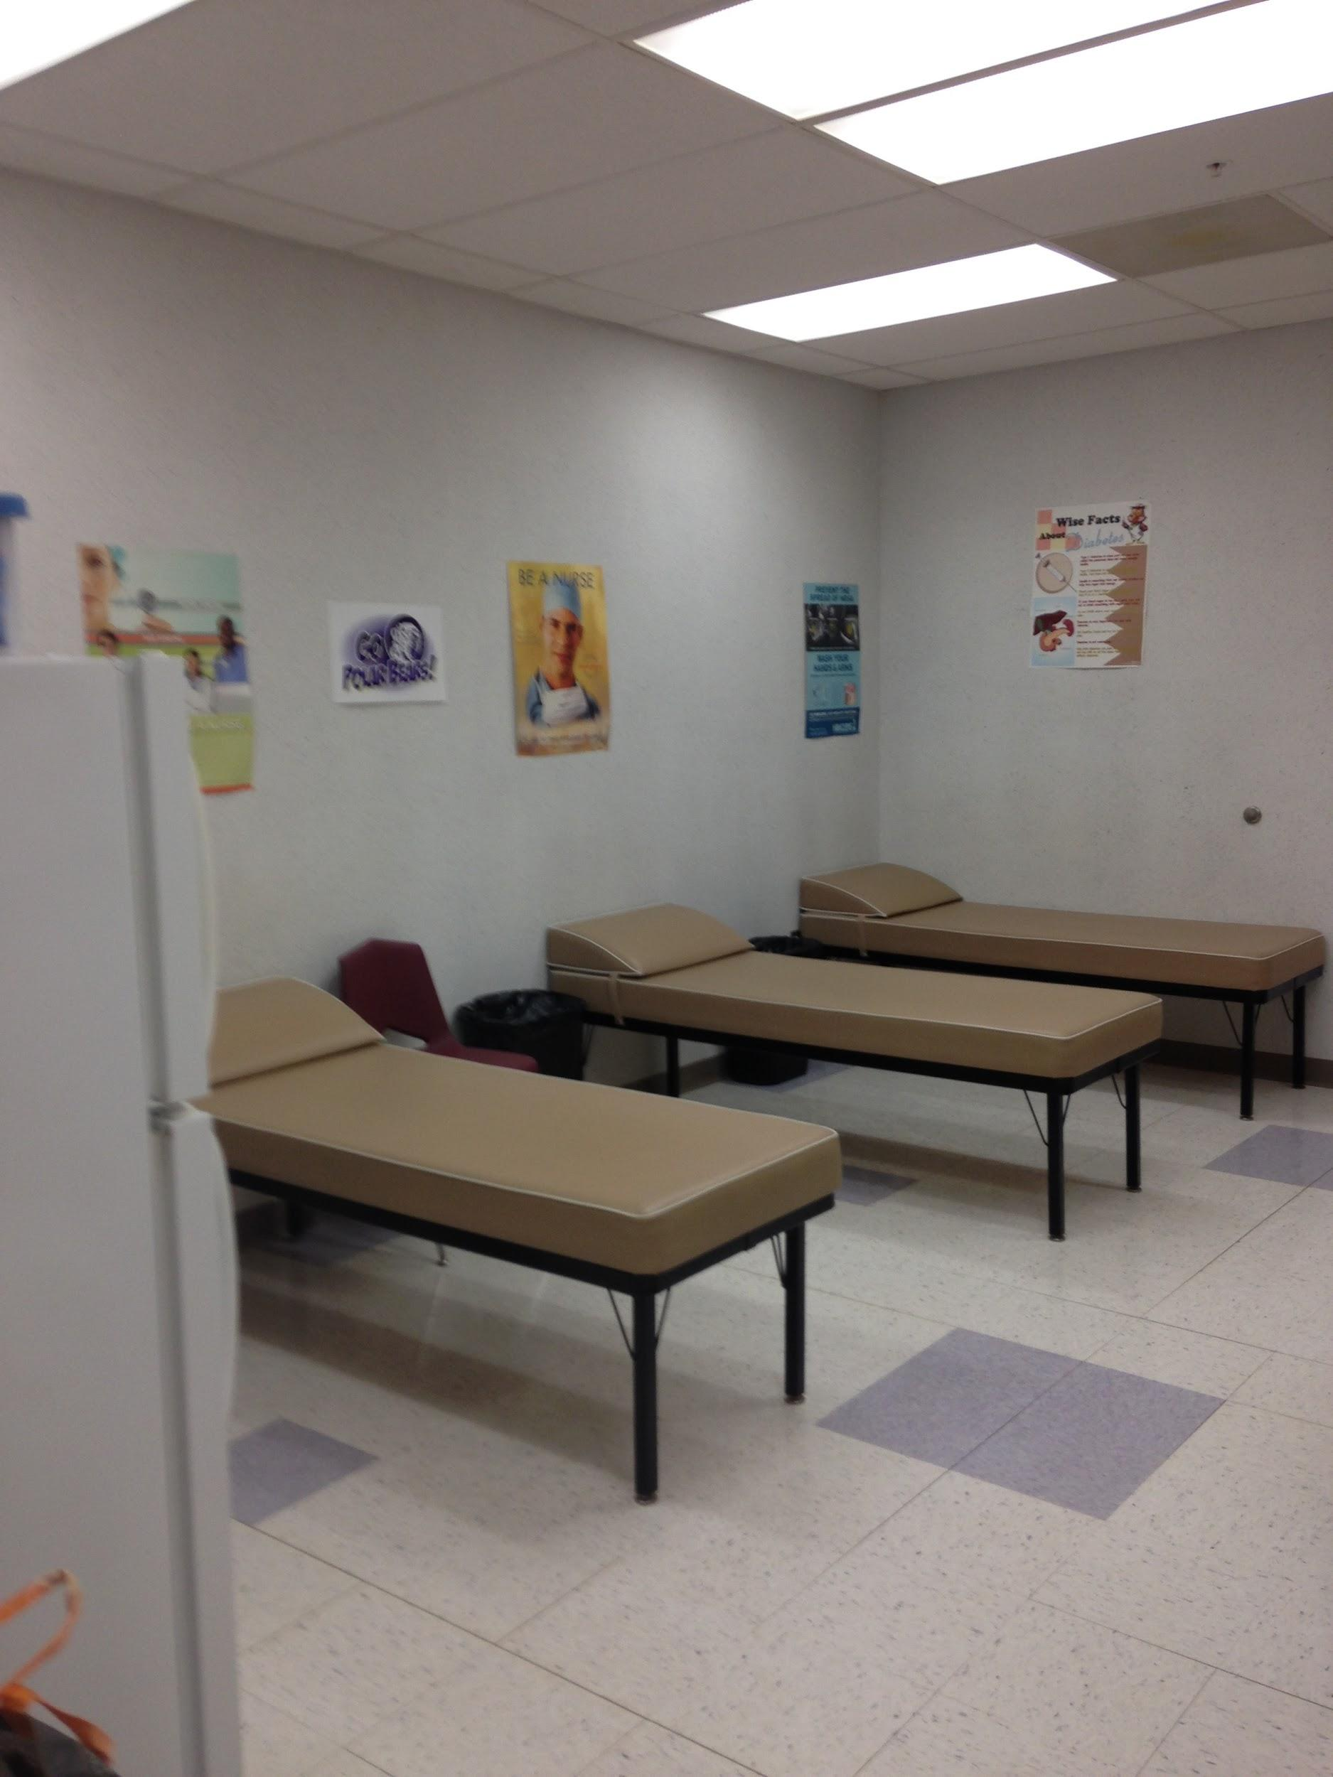
Clinic
If you’re not feeling well, you may visit the clinic. If necessary, your family may be called.

Slide 14
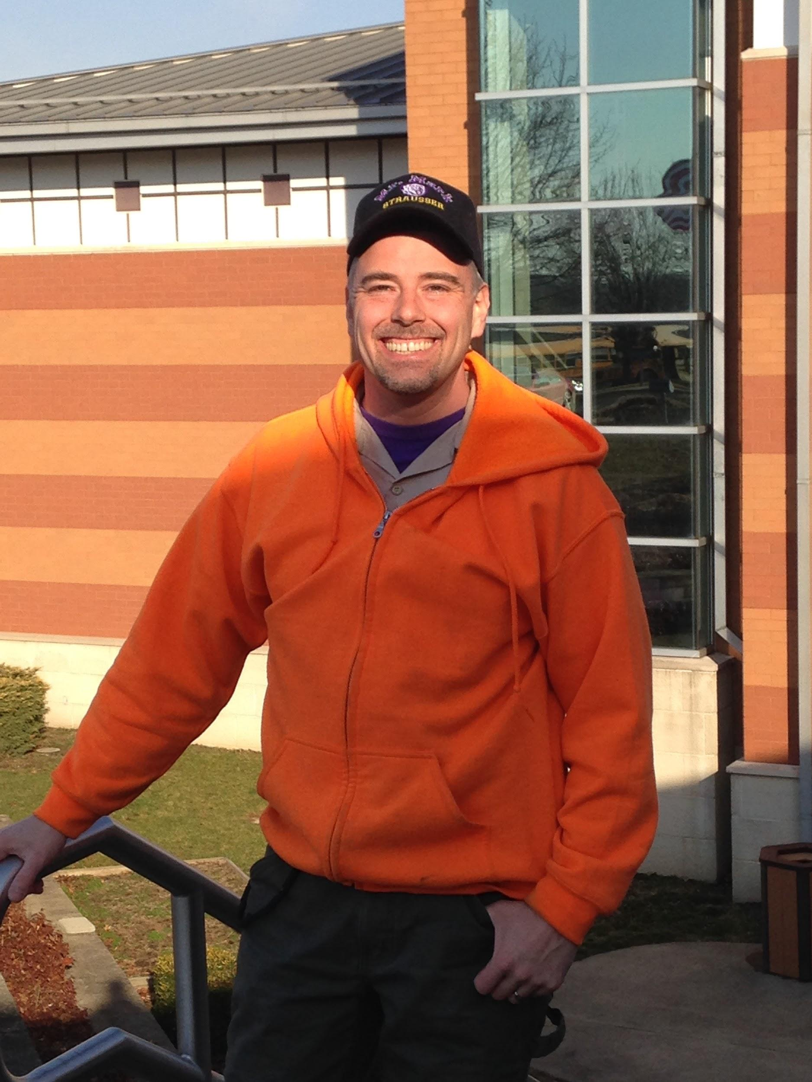
Meet your Custodian!
Mr. Snyder works hard each day to keep the school clean, safe, and comfortable. You can help him by picking up after yourself.

Slide 15
Here’s your tremendous Parent/Teacher Group
Follow us on Facebook:
Strausser Elementary PTG
PTG Sponsored Events:
Fall Kick-Off Party
Halloween and Valentine Parties
Fall and Spring Book Fair
Winter Family Fun Night
Boy’s Bowling
Girl’s Gala
The Strausser Elementary PTG hosts several student centered activities throughout the year. Please be sure to check your child’s backpack throughout the year for exciting news and events. All PTG correspondence is sent home on purple paper. Also, don’t forget to sign up at the start of the year to be on the PTG email list.

Slide 16
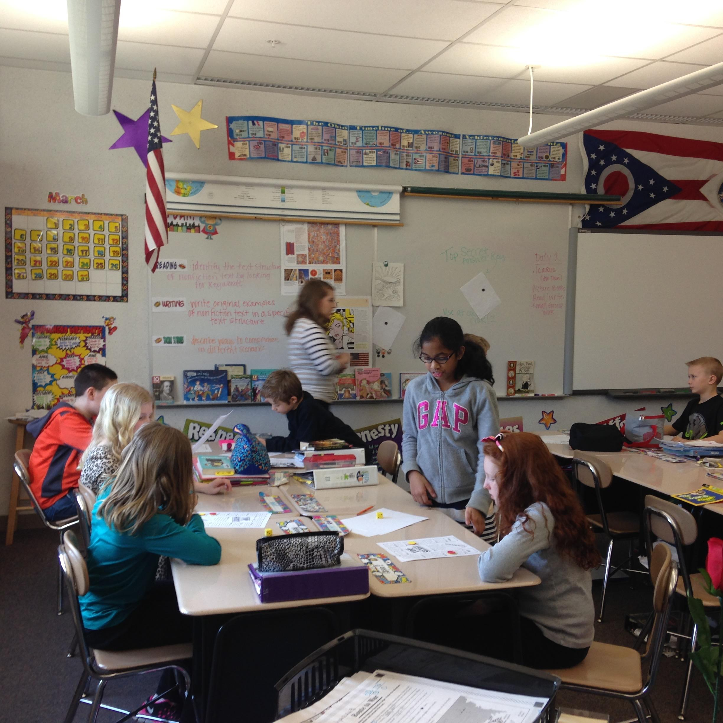
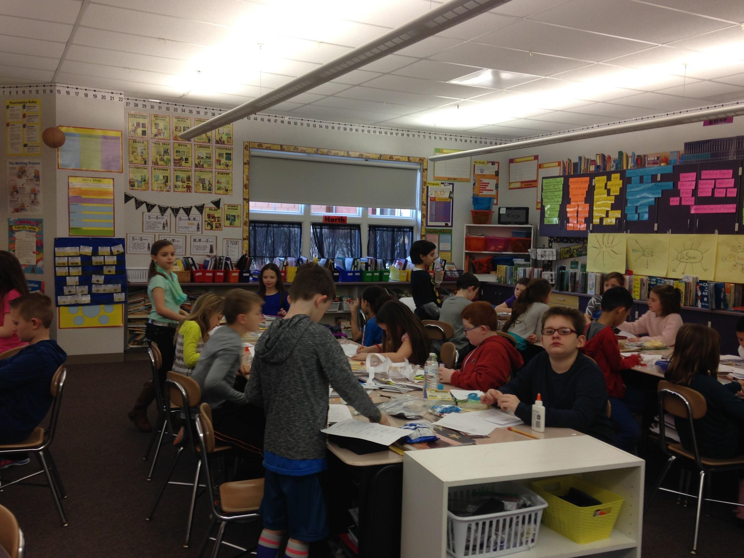
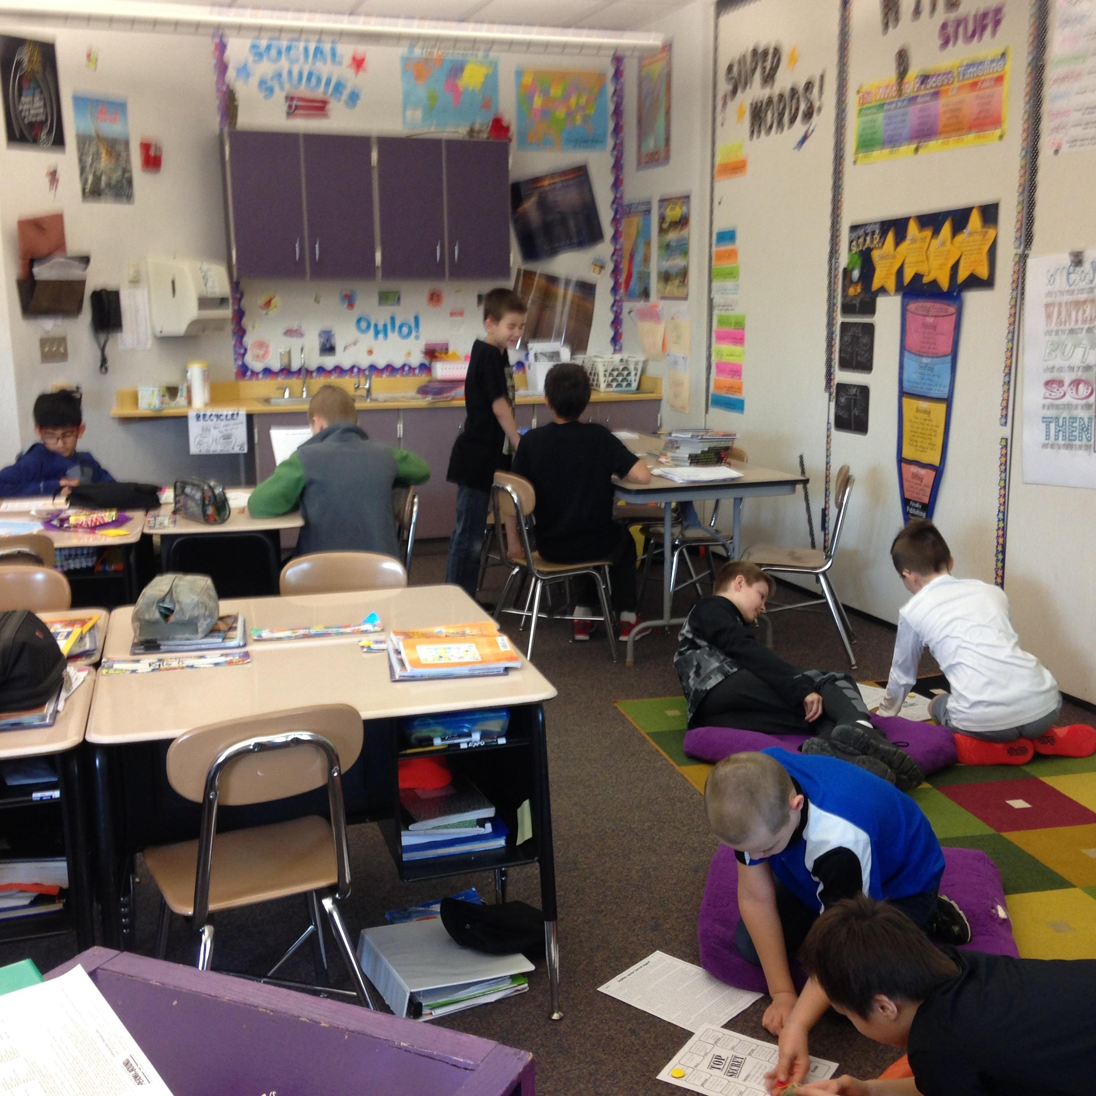
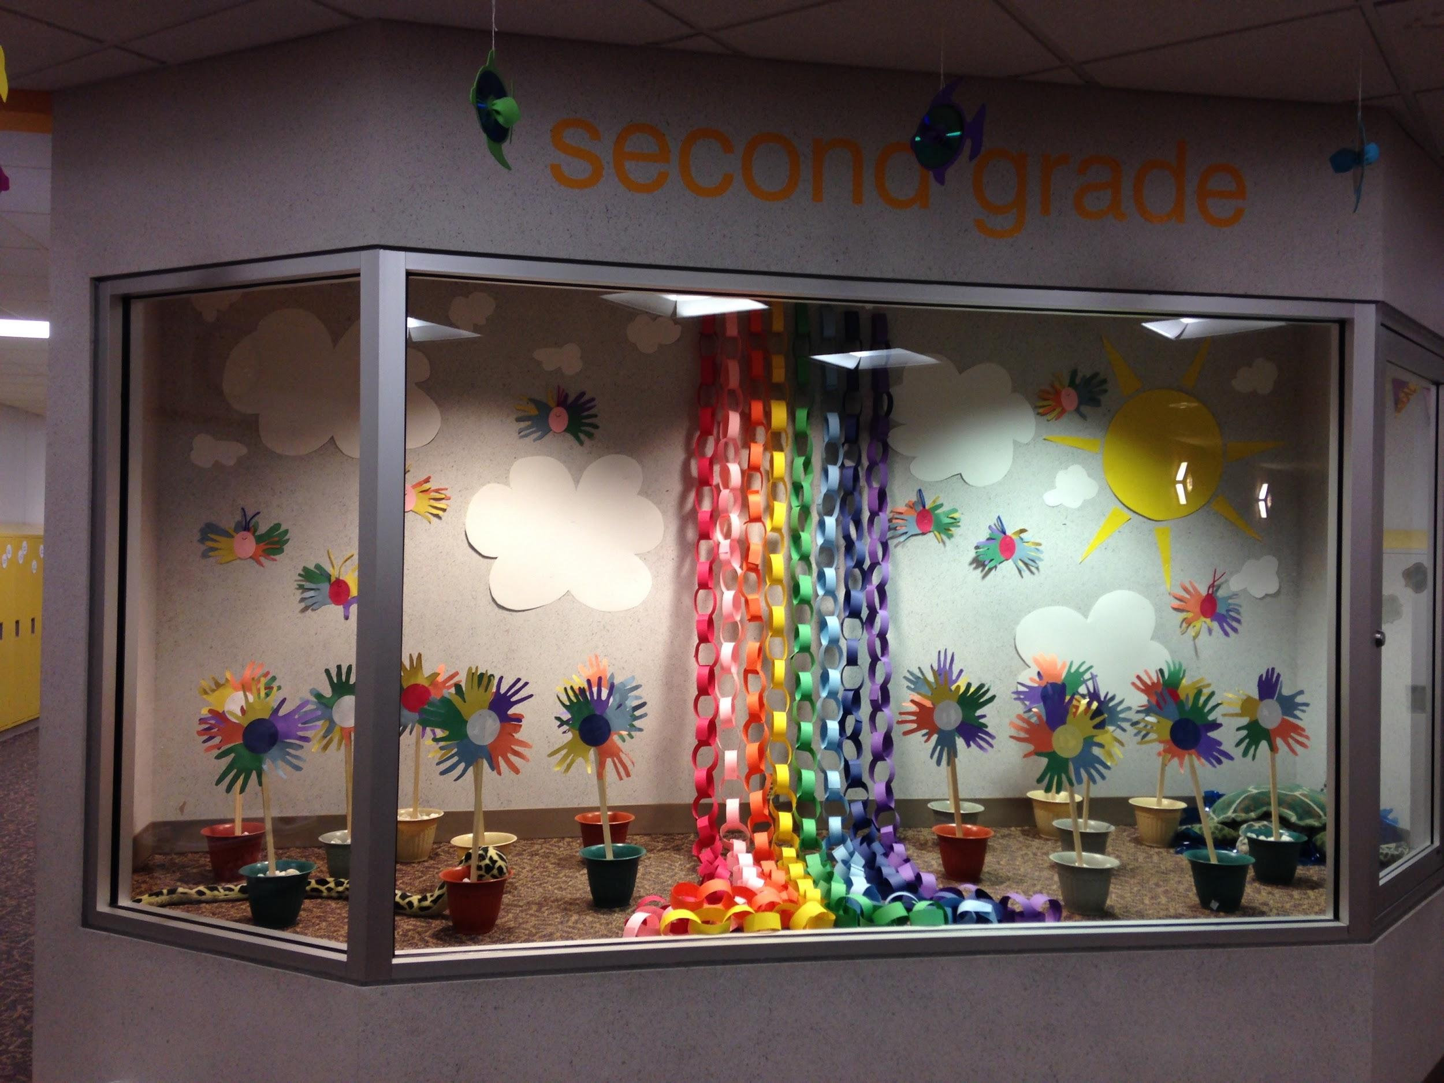
Here are some photos of classrooms.

Slide 17
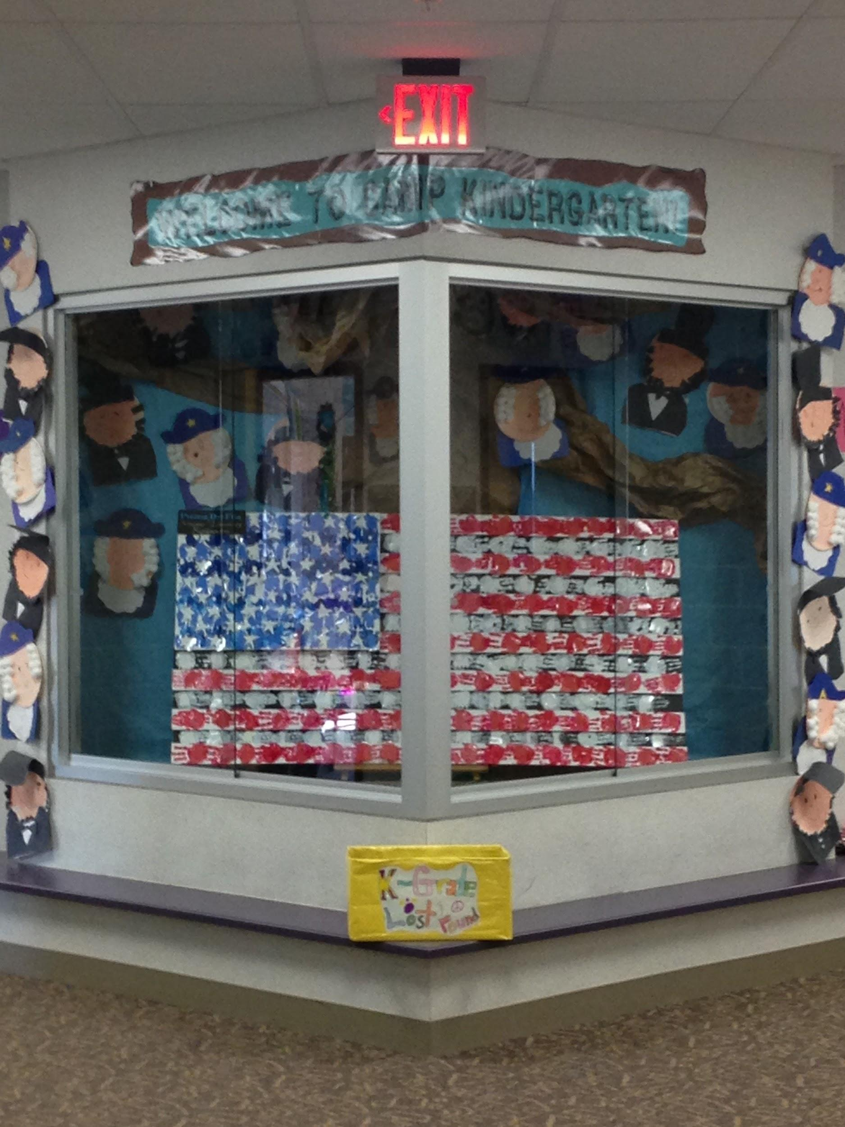
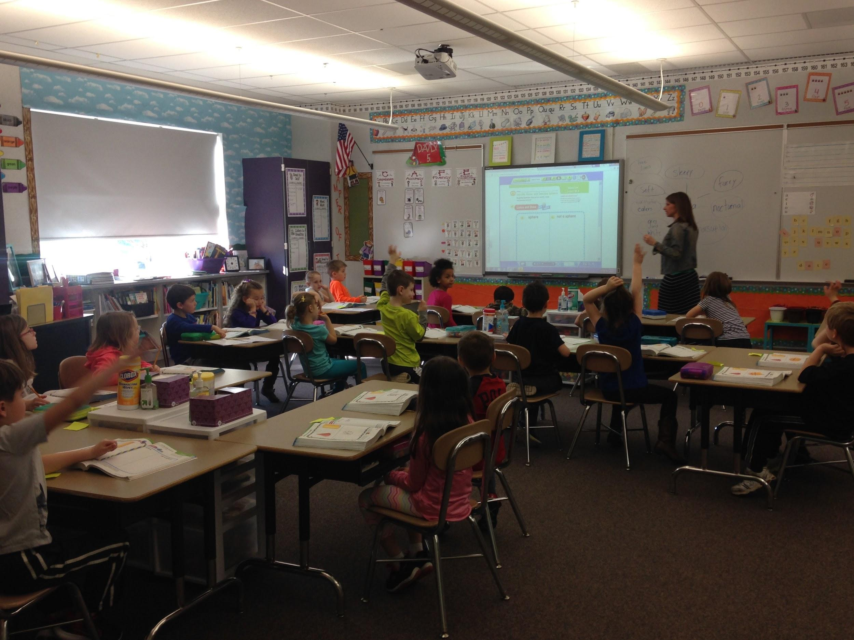
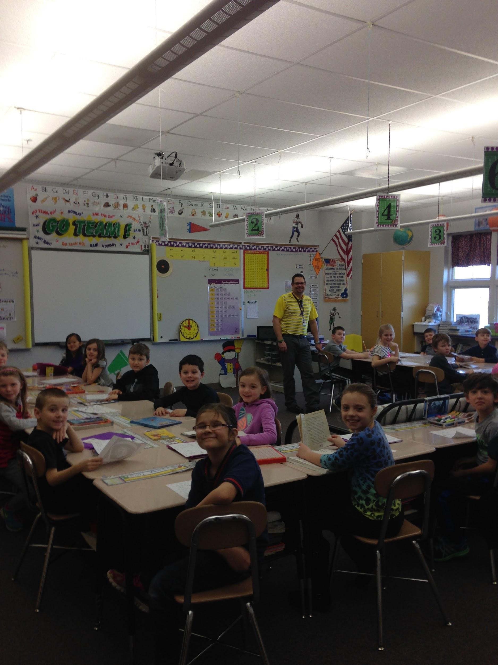
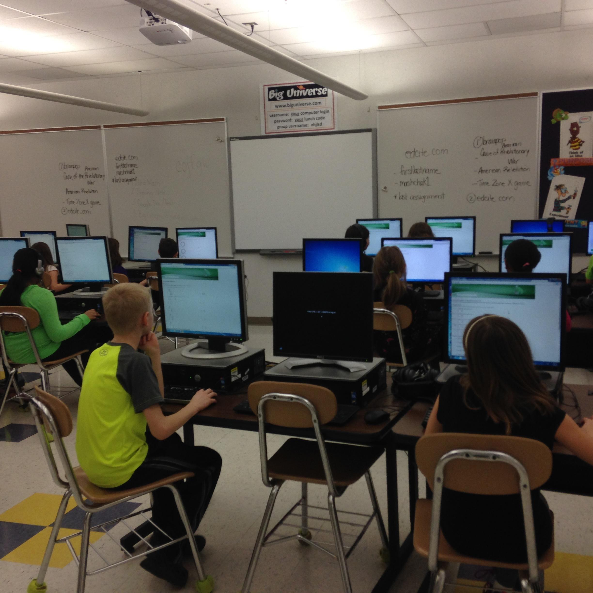
Here are some photos of classrooms.

Slide 18
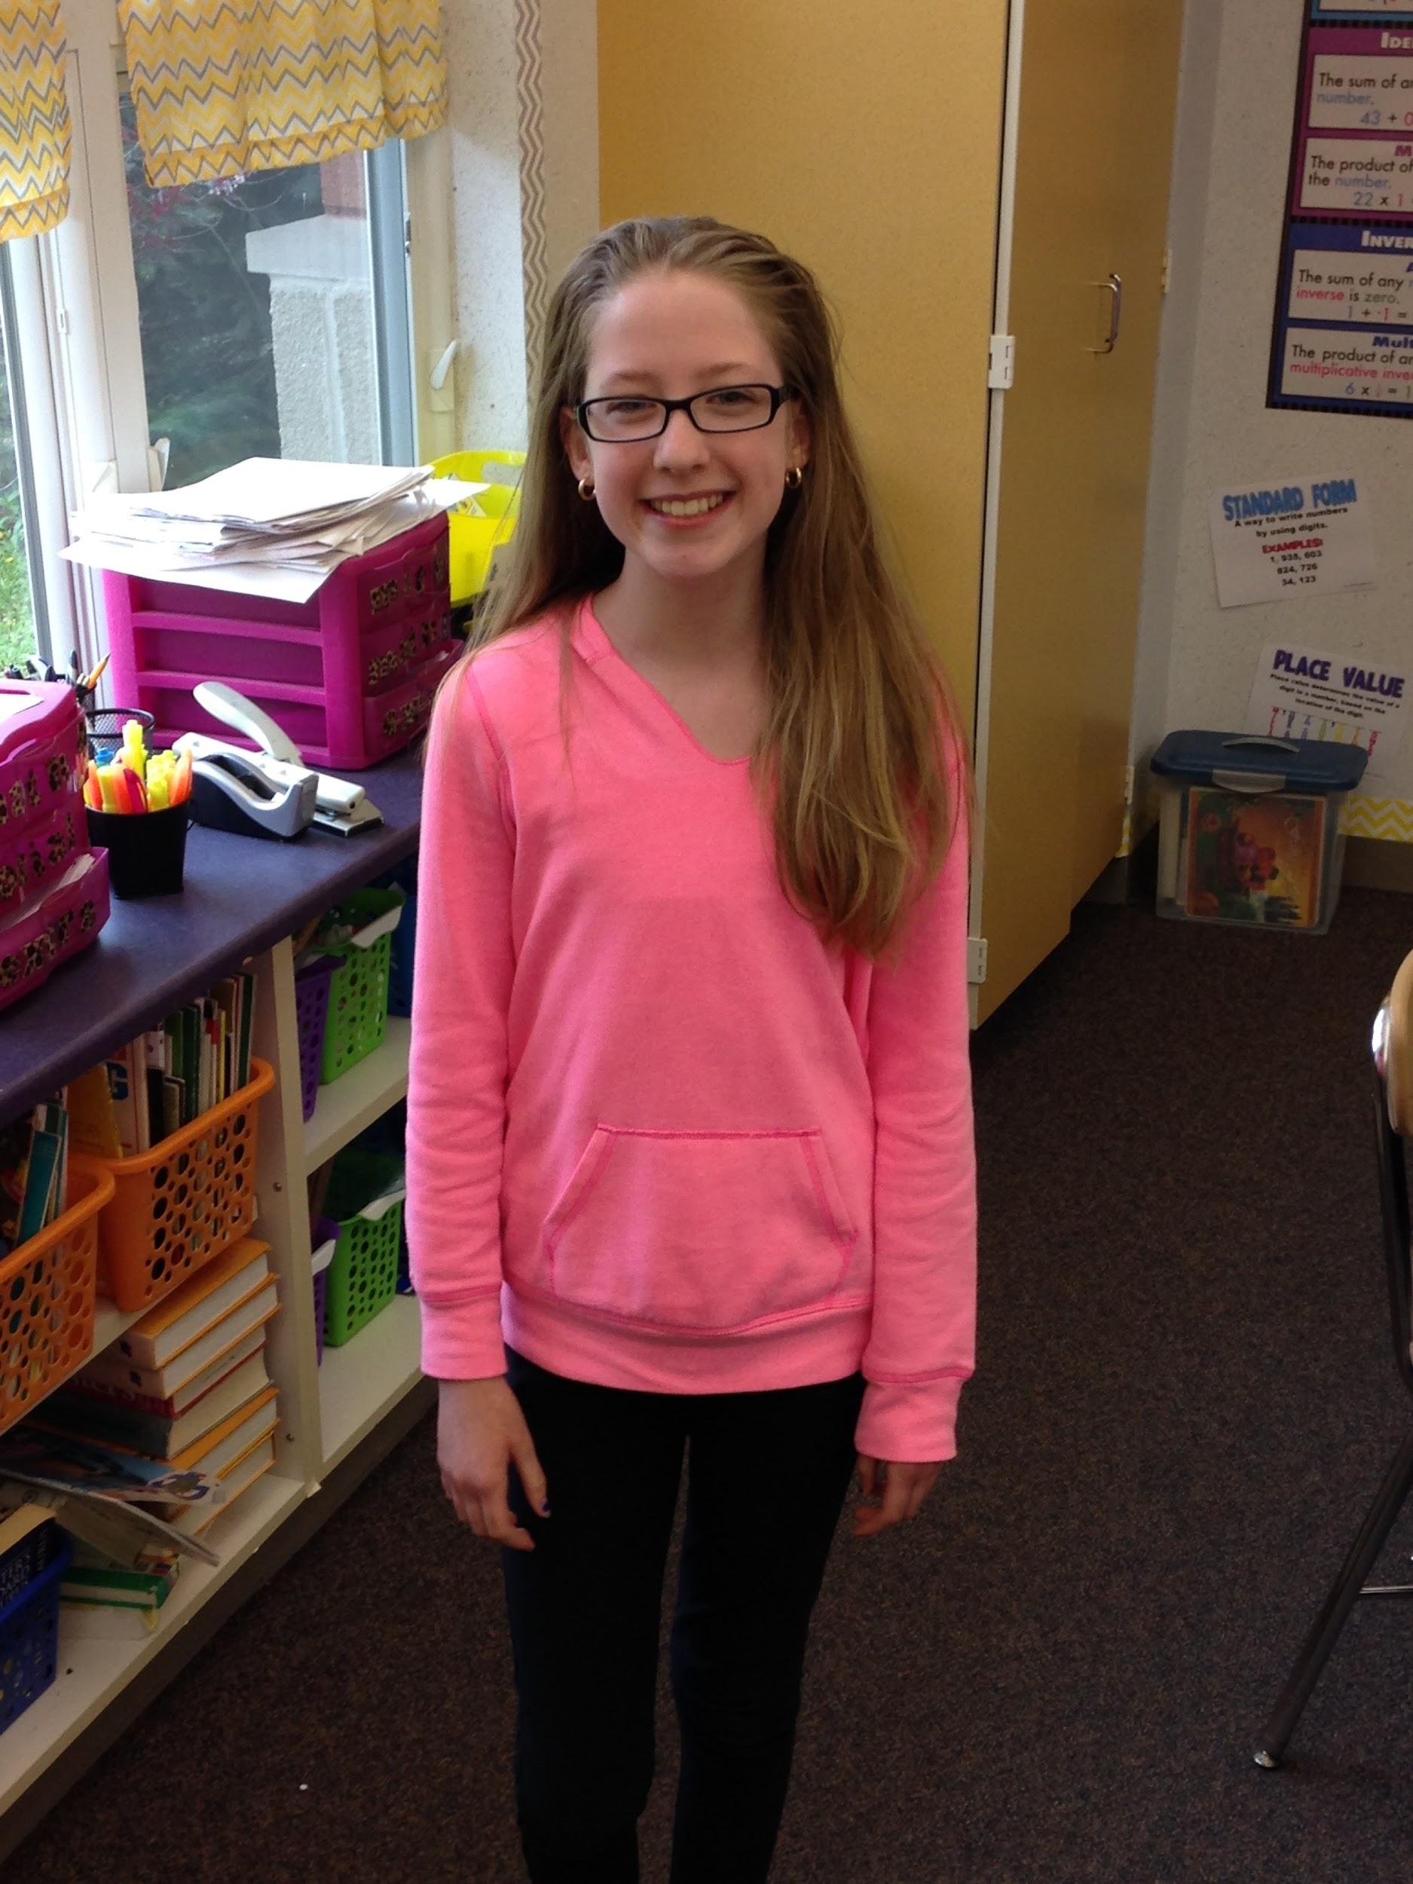
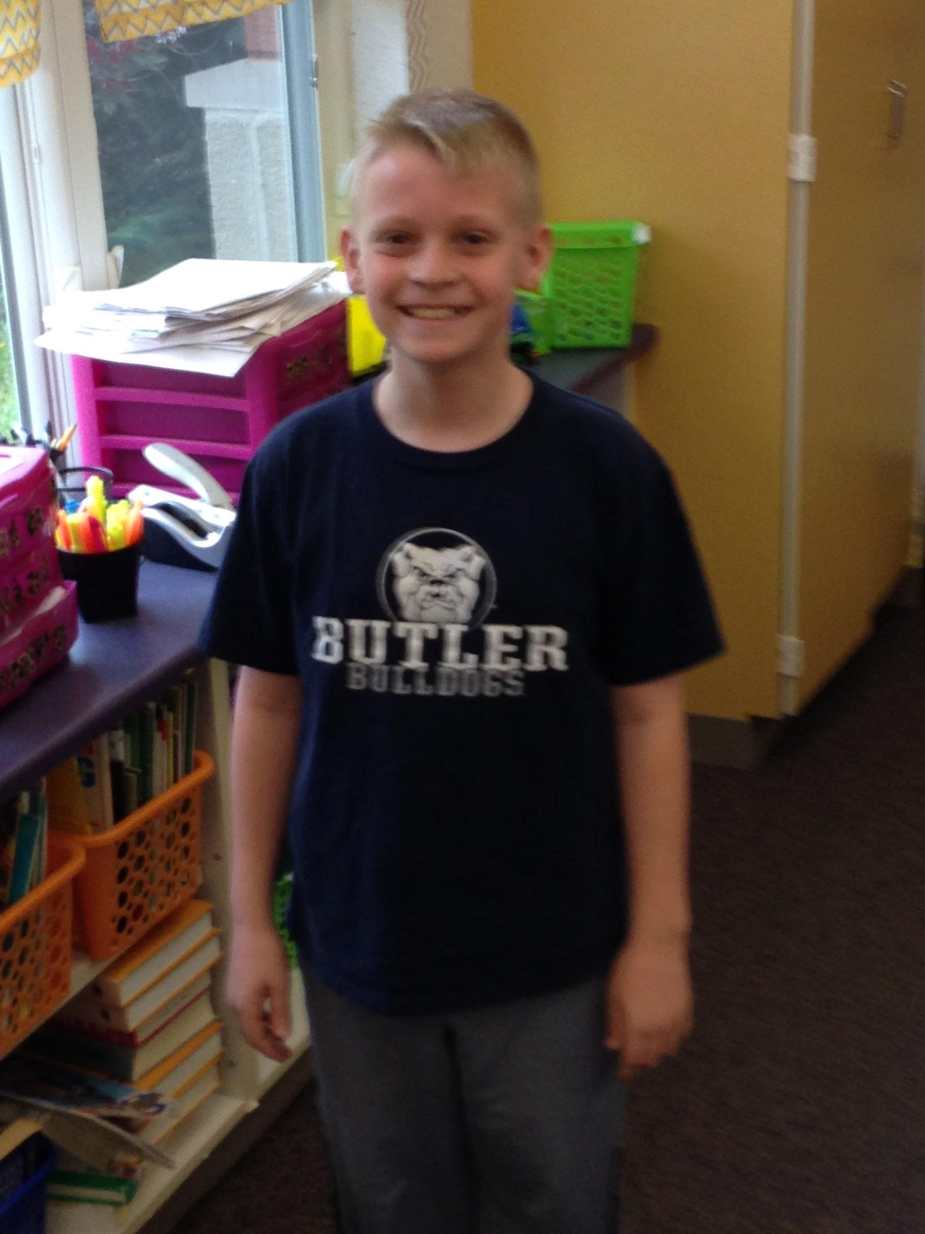
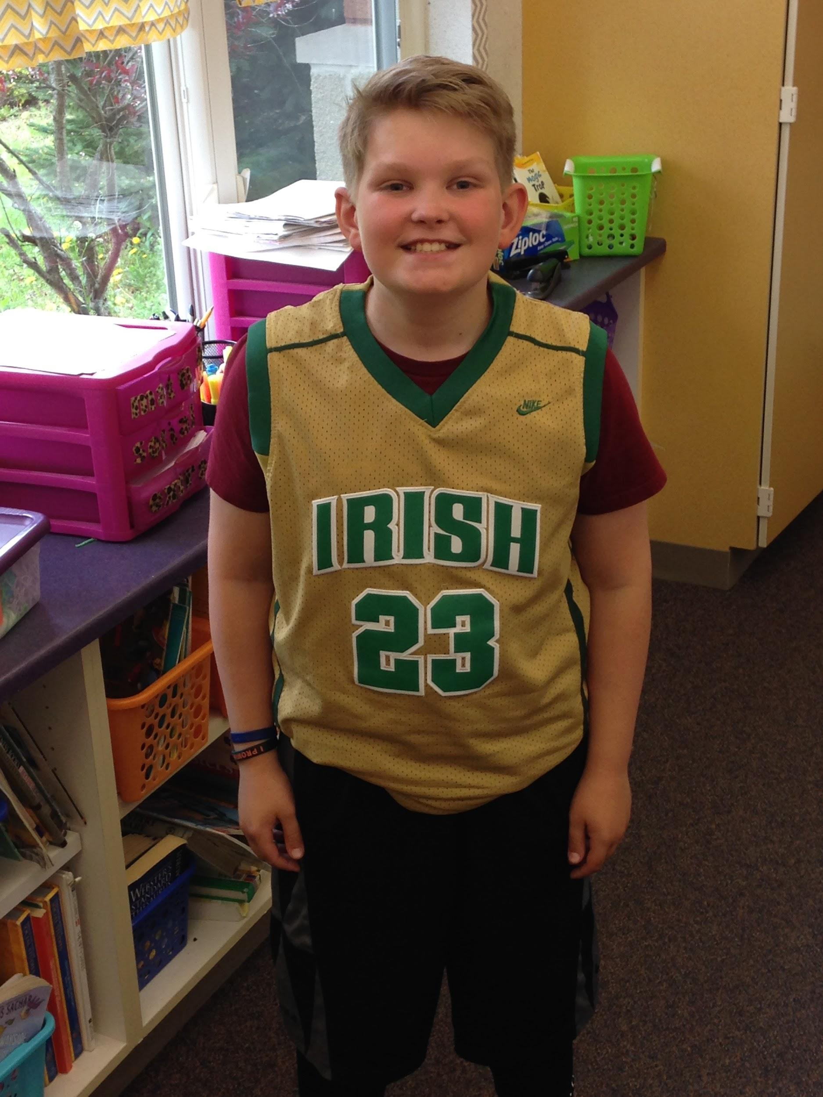
Here are testimonials from students in your building.
Lauren B.
Sammy H.
Aaron W.
Please click student images in order to hear testimonials.

Slide 19
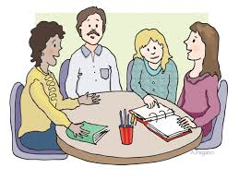
Classroom Pages
Please click here. You can access each teacher’s website!
This is a great way to stay connected to teachers in the district. You can keep up with current events and expectations!

Slide 20
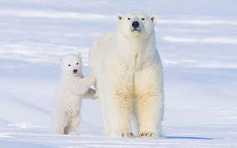
We’ll stand by you every step of the way!

