Slide 1
Building a Speech
Chapter 9, Section 2: The Body of a Speech

Slide 2
The Body of a Speech
The body of the speech is where you demonstrate in an organized manner your powers of persuasion & reasoning.
You prove the point you made in your thesis in the body of the speech - it is the most important part of any speech!

Slide 3
Outlining a Speech: Purpose Statement
An outline is a speaker’s map. It contains 4 main parts:
Purpose statement: similar to a thesis statement, this is the most important part of your outline.
states the purpose of your speech, giving it focus.
Always included in the introduction to the speech
Listed at the top of the outline AND in the introduction

Slide 4
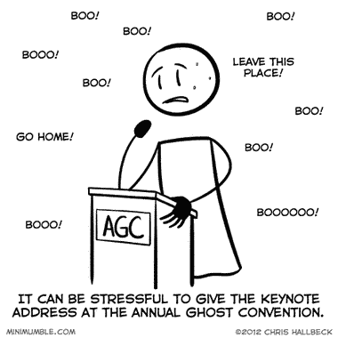
Outlining a Speech: Main Headings
Main Headings are the major division areas, or arguments of your speech (Indicated by roman numeral).

Slide 5
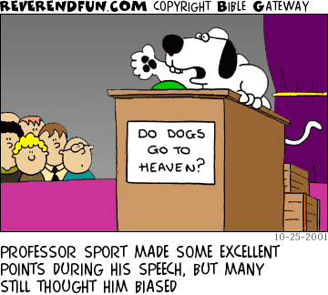
Outlining a Speech: Supporting Materials
Supporting materials provide intensification & reinforcement for the main headings.
Each main heading has its own supporting statement.

Slide 6
Outlining a Speech: Details
Details provide information that break down supporting materials to pinpoint accuracy.
Examples include names, dates, events, statistics, or personal stories.
An illustration is an example that clarifies your point or adds a human note to your speech.
Analogies are comparisons that uses something familiar to explain or describe something less familiar.

Slide 7
In-Class Practice
With a partner, turn to page 221 of your textbook.
Can you identify the elements of an outline in the example? Collaborate to answer the questions in your notes. (~5 minutes)

Slide 8
Organizational Patterns
There are 5 common ways to organize a speech. Keep in mind that organizational patterns can be combined for greater effect.
Chronological Pattern: puts things in a time sequence (in the order in which they happened).
Best option if you want your audience to see the parts of your speech building into a complete picture from beginning to end.

Slide 9
Organizational Patterns
Climactic Pattern: organize main headings in order of importance.
Gives speech dramatic impact by allowing the speech to build in significance.
Save your most important point for last.

Slide 10
Organizational Patterns
Spatial Pattern: dividing your topic on the basis of space relations.
Example:
Introducing the Modern School -
I. Library is the central hub
II. Classrooms radiate from the library
III. Offices are extensions

Slide 11
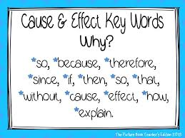
Organizational Patterns
Cause & Effect Pattern: “because of that, this happened.”
Main headings for an outline of this pattern are labeled as Causes & Effects.
Supporting materials provide analysis of each cause & effect.

Slide 12
Organizational Patterns
Problem-Solution Pattern: presents a problem, then discusses how to solve it.
Policy solutions asks the audience to participate politically in the suggested solution.
Attitudinal solutions ask the audience to change or modify their opinions and moods.
Awareness solutions ask the audience to be conscious of what they have heard and possibly implement it in their own lives.

