Slide 1
ART ELEMENTS
Line
Shape
Space
Form
Value
Texture
Color

Slide 2
WHAT ARE ART ELEMENTS??
Art Elements make up nearly everything found in a piece of Art.
A piece of Artwork can have 1, 2 or even ALL 7 of the Art Elements.
Art Elements are the basic fundamentals of ART.

Slide 3
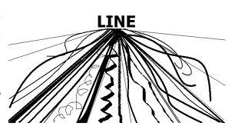
LINE
A dot that went for a walk.
LINE can be shown in a variety of ways.

Slide 4
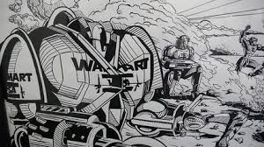
LINE
Line can be found in almost every drawing and painting.
CAN YOU IDENTIFY LINE IN THIS DRAWING???

Slide 5
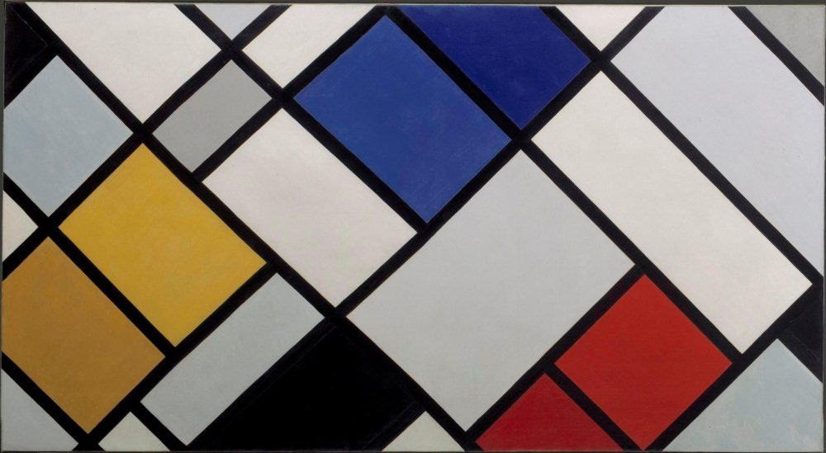
LINE
HOW ABOUT THIS PAINTING...
CAN YOU IDENTIFY LINE???

Slide 6
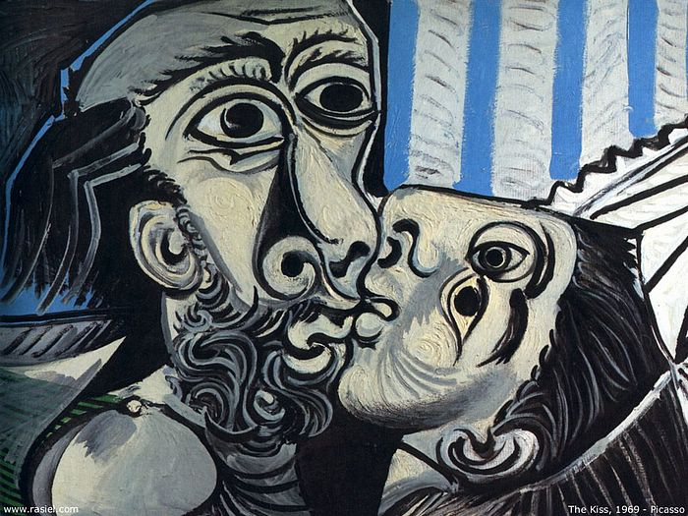
LINE
EVEN THIS PAINTING???

Slide 7
SHAPE
An area enclosed by line.
Nearly all artwork has some sort of SHAPE.
Shapes come in all sizes and vary in each individual artwork.

Slide 8
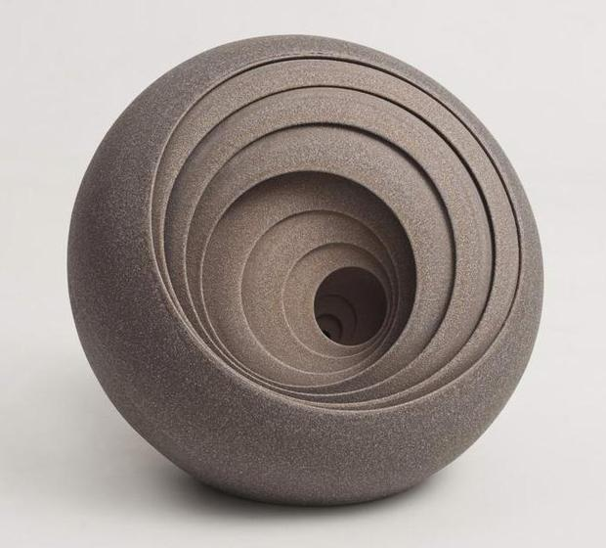
SHAPE
Shapes can also be found in the majority of artwork. Especially in 3-Dimensional Art.

Slide 9
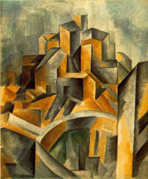
SHAPE
Can you find the shapes in this Painting?

Slide 10
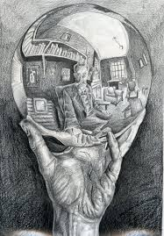
SHAPE
How about this drawing?

Slide 11
VALUE
The lightness or darkness of a surface.
Value can often mean the tint or tone of a color.
Value can be added to 2-dimensional objects to make them 3-dimensional.
The amount of light that hits a surface, often times effects the VALUE.

Slide 12
Value Scale
A range of values that transition from dark to light.

Slide 13
Gradation
Gradation scale- is a transition from dark to light.

Slide 14
Gradation
Gradation scale- is a transition from dark to light.

Slide 15
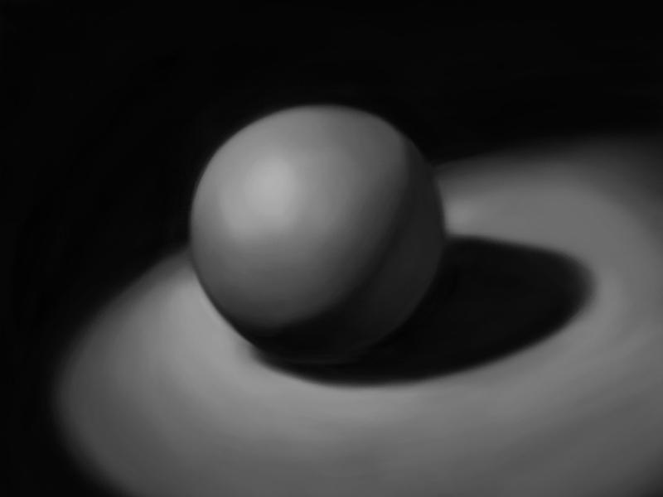
VALUE
HOW DOES THIS ARTIST USE VALUE????

Slide 16
TINT vs SHADE
Tints and shades are often added during a painting.
Tints- are typically added to show light hitting a surface.
Shades- are typically added to show shadows.

Slide 17
FORM
3-Dimensional OR occupying space.
Often times has value and/or casts a shadow.

Slide 18
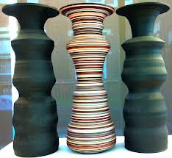
Form
Form can be found in the majority of Sculptures, ceramics, architecture or any other 3-dimensional artwork.

Slide 19
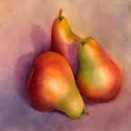
FORM
Form can also be found in 2-Dimensional artwork, such as drawings, painting, printmaking or photography.

Slide 20
SPACE
The illusion of objects having depth on a 2-dimension surface.
Space is often shown by:
Overlapping objects
Changing the size of objects
Having a foreground, middle ground and background

Slide 21
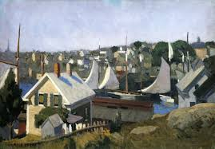
SPACE
How does this artist create the illusion of space within this painting.

Slide 22
SPACE
Space can also be shown in other 2-dimensional artwork such as photography, printmaking, drawing or etching.

Slide 23
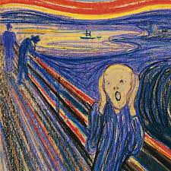
SPACE
How does the artist show space within this painting?

Slide 24
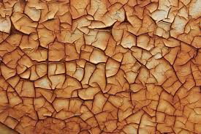
TEXTURE
Texture is the implied feeling on a 2-dimensional surface.
Texture recommends that an object has a certain feel to it.

Slide 25
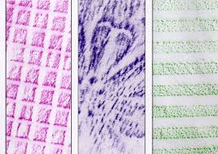
TEXTURE
Crayon rubbing...

Slide 26
COLOR
The amount of light reflecting off of a surface.
ROY-G-BIV
There are many categories of color such as:
Primary, Secondary, Complimentary, Analogous, Tertiary, warm, cool etc.

Slide 27
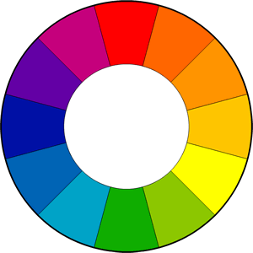
COLOR WHEEL

Slide 28
COLOR
While painting, color can be manipulated and altered by mixing 2 or more colors.
Mixing 2 primary colors will give us a secondary color.
Color can be used in nearly all areas of ART including:
Drawing, painting, glazing, sculpting, architecture, photography etc.

Slide 29
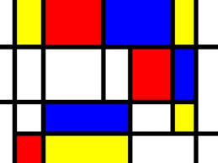
COLOR
How does this artist use color within his painting?

Slide 30
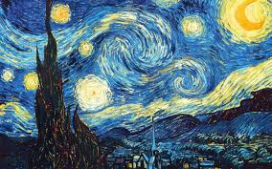
COLOR
How does Van Gogh choose to use color within his artwork?

